Slide 1
HMIS Advisory
Committee Meeting
Central Florida Commission on Homelessness (CFCH)
CoC FL-507
March 14th, 2023
Wyatt Haro, Committee Chair
Notes:
Call to order: Wyatt -All in attendance verify name, add agency
Next slide: Wyatt (agenda)

Slide 2
HMIS Advisory Committee Mission
HMIS Advisory Committee Purpose
Our mission is to effectively use data, which includes inputs from those in need of services, those providing services, and from members of the community, to eliminate homelessness in Central Florida.
Oversee the CoC’s implementation of HMIS, what we do with the data and how we use it.
Notes:
Presenter: Wyatt
Next Slide: Wyatt

Slide 3
HMIS Advisory Committee
Chair | Wyatt Haro | Miracle of Love
Vice Chair | Vacant
Secretary/Recorder | Vacant
Voting Member | Brad Sefter | Health Care Center for the Homeless
Voting Member | Latoya Sheffield | Wayne Densch
Voting Member | Danielle Landaal | IDignity
Voting Member | Vacant
Voting Member | Vacant
HMIS Team Liaison | Brittney Behr | HSN - HMIS Project Coordinator
Notes:
Presenter: Wyatt -Committee Roll Call -July Minutes Roll Call Vote (Meeting Minutes - HMIS Advisory Committee 2022-07-12 (hmiscfl.org))
Next Slide: Wyatt (Agenda Roll Call)

Slide 4
Agenda
Call to Order
Committee Roll Call
Roll Call Vote - Minutes from Jan 10th, 2023
Roll Call Vote - Agenda for March 14th, 2023
HMIS Team Reports:
YHDP Updates - Special Guest Aja Hunter
Reporting Season Update - LSA Results
Reporting Season Update - SPMS
HMIS Training and Data Quality Monitoring
Proposed changes to the Data Quality Plan
HMIS Feedback Survey Results
HMIS Governance Updates
COMMITTEE VOTE - All motions before committee
Notes:
Presenter: Wyatt -Agenda Roll Call Vote
Next: Wyatt

Slide 5
Officer Reports
YHDP Updates - Aja Hunter
Reporting Season Update - LSA Results - Brittney Behr
Reporting Season Update - SPMs - Brittney Behr
Training and Monitoring Updates - Racquel McGlashen
DQP Updates - Ashley Brozenske
HMIS Feedback Survey Results - Angel Jones
Governance Updates - Chuck Vroman
Notes:
Presenter: Wyatt
Next Slide: Aja

Slide 6
YHDP Updates
HSN HUD Award: Youth Homelessness Demonstration Program of $8.4 million
Focus: Create and implement a Coordinated Community Plan to prevent and end youth (18-24) homelessness
Timeline:
Funds used over 2 yrs (can renew up to $4.2 million every yr in NOFO)
Given six months of planning (Nov 22- April 23)
Planning Team
Youth Action Board
Coordinated Community Plan
Statement of Need
Mission, Vision, Goals
Governance Structure
Projects to be Funded
Local RFA- May
Projects selected- July
Notes:
Presenter: Aja
Next: Brittney

Slide 7
YHDP- CCP Updates
Mission:
Central Florida will utilize YHDP as a catalyst to ensure YYA experiencing houselessness have access to timely, equitable, and affirming support to attain success in leadership, housing, education, employment, well-being, and relationships. This journey is urgently driven to share leadership and responsibility with YYA experiencing houselessness.
Vision:
All houseless youth and young adults have a pathway to obtain and maintain a safe, stable, and secure home.
Goals:
1) YYA LEAD: Central Florida collaborates with YYA that have lived experience of houselessness, to prioritize and uplift youth voices throughout the implementation of YHDP.
2) IDENTIFICATION: Central Florida identifies all unaccompanied YYA experiencing or at risk of houselessness to understand their unique needs as well as ensures timely connections to needed resources
3) HOUSING: YYA are provided choices through diverse, flexible, and low barrier housing options. These options are immediate, safe, supportive and reflect individualized needs to ensure long-term stable housing.
4) EDUCATION AND EMPLOYMENT: Central Florida strengthens cross system collaborations to support all YYA in the exploration and achievement of their educational and career goals. Any support given to YYA is tailored to their needs to ensure empowerment and self guided decision making.
5) HEALTH AND PERMANENT RELATIONSHIPS: The health and wellbeing of YYA are prioritized by meeting youth where they are and providing them with the resources, supports, and permanent connections they need to achieve stability, health, and self sufficiency.
Notes:
Presenter: Aja
Next: Brittney

Slide 8
Key Points to Keep in Mind Regarding HMIS Numbers
Understanding the “Relationship to Head of Household” for counting Households
Understanding how Project Types evaluate Homelessness differently:
Emergency Shelters (ES), Transitional Housing (TH) & Street Outreach (SO) - All enrollments count participants’ as Homeless
Coordinated Entry (CE), Supportive Services Only (SSO) & Other (OT) - Use “Prior Living Situation” to determine Homeless status
Rapid Re-housing (RRH) & Permanent Supportive Housing (PSH) - Use the “Housing Move-In Date” to determine Homeless status
Notes:
Tino

Slide 9
Statement of Need:
Central Florida Commission on Homelessness Served 916 YYA HH between the ages of 15-24.
Population | Data Source(s) 10/1/21-9/30/22 | Estimates of # of Youth
At-risk unaccompanied youth* 18-24 | HMIS HP, CE, SSO & OT Enrollments | 363
Unaccompanied youth experiencing homelessness* 18-24 | HMIS ES, TH, PSH, RRH, CE, SSO & OT | 630
At-risk pregnant or parenting youth 18-24* | HMIS HP, CE, SSO & OT Enrollments | 34
Parenting Youth experiencing homelessness 18-24* | HUD: Stella P ES, TH, PSH, RRH | 103
Pregnant Youth experiencing homelessness 18-24* | HMIS ES, TH, PSH, RRH, CE, SSO & OT | 14
LGBTQ+ and gender non-conforming youth** 15-24 | HMIS HH Gender non-conforming (Gender is recently updated question by HUD 1/23) | 31
Notes:
Aja

Slide 10
Race by Gender Matrix (FY: 10/01/2021 to 09/30/2022)
 | Gender
Race | Female | Male | Multiple Genders, Transgender & Other | Data not collected | Grand Total
Black, African American, or African | 326 | 175 | 8 |  | 509
White | 166 | 162 | 9 | 2 | 339
American Indian, Alaska Native, or Indigenous | 2 | 3 |  |  | 5
Asian or Asian American | 4 | 4 |  |  | 8
Multi-Racial | 17 | 13 | 1 |  | 31
Native Hawaiian or Pacific Islander | 3 | 3 |  |  | 6
Data not collected | 13 | 12 | 2 |  | 27
Client doesn't know | 2 |  |  |  | 2
Grand Total | 533 | 372 | 20 | 2 | 927
Notes:
Aja and Tino

Slide 11
All Youth & Young Adult Enrollments by Project Type: 1,639
Project Type | Count of Enrollments | Unique Participants Within Project Type
Emergency Shelter (ES) | 349 | 288
Transitional Housing (TH) | 40 | 40
Street Outreach (SO) | 235 | 200
Coordinated Entry (CE) * | 340 | 279
Services Only (SSO) * | 363 | 328
Other (OT) * | 113 | 84
Rapid Re-housing (RRH) ** | 168 | 107
Permanent Supportive Housing (PSH) ** | 4 | 2
Homelessness Prevention (HP) | 27 | 27
Notes:
Tino

Slide 12
YHDP- Call to Action
Stay Engaged
Join the Youth Homelessness Work Group
Attend YHDP Youth Provider Meeting April 2023
Contact Youth Project Manager- Aja Hunter aja.hunter@hsncfl.org
YAS Recruitment (15-24)
valerie.perez@hsncfl.org

Slide 13
HMIS Reporting Season 2023
It’s that magical time of year again! The first quarter of the calendar year has a lot of important HUD reporting deadlines. During this time, we will be reaching out to organizations to correct and update data. We encourage you to reach out to the Helpdesk if you need any support during this process.
We greatly appreciate your efforts to help us ensure accurate reporting. Thank you!
1/13/2023
Longitudinal Systems Analysis (LSA)
The LSA includes a 3-year lookback of system-level data that can be filtered by demographics and system pathways. It gives a high-level understanding of a system’s response to homelessness. Stella-P uses LSA data to generate charts. View 2022’s submission here on our website)
2/28/2023
System Performance Measures (SPMs)
SPMs are a series of 6 metrics used to evaluate effectiveness of a homeless response system. SPMs include: length of time homeless, first-time homeless, total homeless, exits to permanent housing, returns to homelessness, and income growth. View this year’s submission here on our website
TBD - April 2023
Point-in-Time Count (PIT)
The PIT count is an annual survey of people experiencing homelessness in our service area on a single night (the actual count can be performed over multiple days). PIT data includes people in emergency shelters and transitional housing, as well as people engaged on the streets or in another unsheltered location. View last year;s submission here on our website
TBD - April 2023
Housing Inventory Chart (HIC)
The HIC is a count of inventory for projects that provide housing or lodging, including ES, TH, RRH, PSH and OPH projects. This is used along with the PIT to determine utilization of a homeless response systems dedicated resources. This data is updated once a year prior to submitting. View last year’s submission here on our website
Notes:
Presenter: Brittney
Next Slide: Brittney

Slide 14
How You Can Help
Run an APR (with drill-down) to find and correct the following errors…
Relationship to Head of Household
Date of Birth
Gender
Race
Ethnicity
Enrollments over 365 days - possible missed exits
Exit Destination
Make sure to enter move-in dates! (IMPORTANT)
If you need assistance, please reach out to the helpdesk
Notes:
Presenter: Brittney
Next Slide: Rocky/Tyler

Slide 15
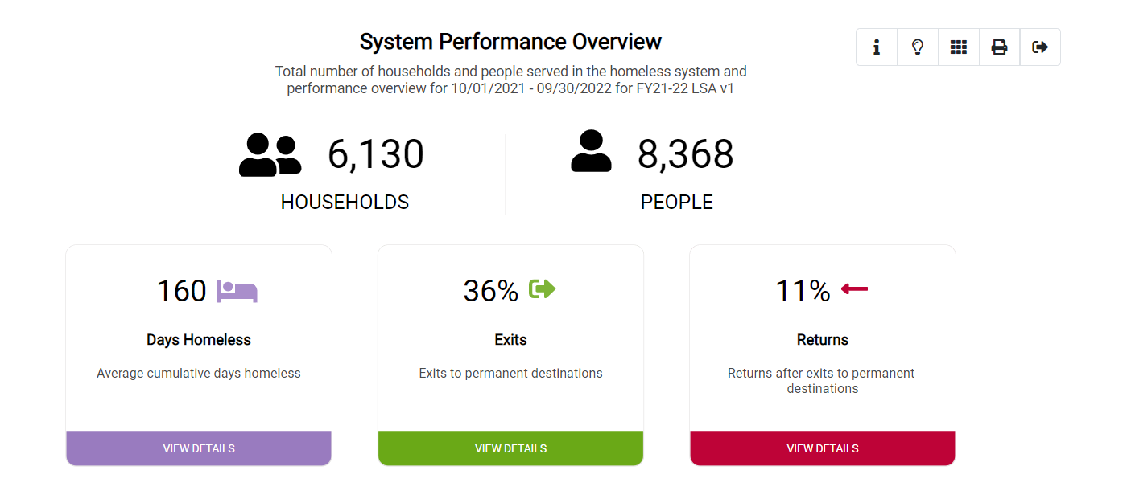
LSA Results
2021: 129 days
2021: 38% positive exit rate
2021: 13% returns in 6mos
Notes:
Presenter: Brittney
Next Slide: Brittney

Slide 16
LSA Findings
Important Data Points for the LSA
Missing Move-in Dates (data warning)
Must be explained by the provider
Overlapping Enrollments (data warning)
Emergency shelter/Transitional Housing projects cannot have overlapping bed nights
Duplicate enrollments
Long lengths of stay in shelter - over 180 days (data warning)
Longer lengths of stay must be explained by the provider
We had no Data Errors in our FY 21-22 submission!
Notes:
Presenter: Brittney
Next Slide: Brittney

Slide 17
What Are System Performance Measures?
System Performance Measures (SPMs) are a selection of metrics used to evaluate system-level performance
SPMs encourage communities to coordinate efforts across different projects and funding sources
SPMs are reported to HUD and are a competitive element in CoC Program Competitions for additional funding (NOFO)
SPMs focus primarily on how the whole CoC is performing, as opposed to specific projects or jurisdictions
Previous years were submitted from ServicePoint - this year, data was submitted entirely from ClientTrack
Notes:
Presenter: Brittney
Next Slide: Brittney

Slide 18
Length of Time Homeless
How long people experience homelessness on average, by their length of stay in Emergency Shelter and Transitional Housing projects, and by their self-reported length of time homeless.
Notes:
This measures the number of clients active in the report date range across ES, SH, TH, and PH (accounted for by “move-in date”) along with their average and median length of time homeless.
This measure also includes 2 variances: One is measured by program Entry Date, and the other is measured by Approx Date Homeless (HMIS data element 3.17)

Slide 19
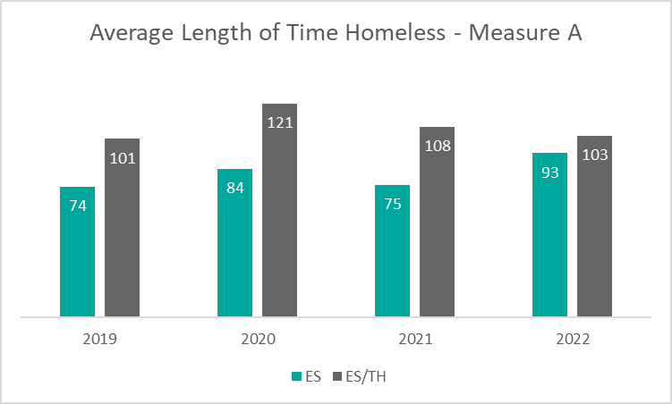
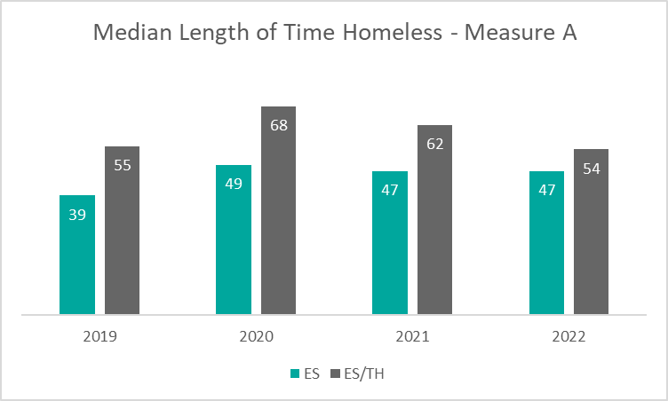
Measure 1A: Length of Time Homeless
Length of time homelessness as measured by average enrollment length in Emergency Shelter increased by almost 20 days.
The median has stayed the same, meaning it is likely a small number of longer stayers contributed to the increase.
When including Transitional Housing, averages and median length of time homeless decreased slightly.
Notes:
Presenter: Brittney
Next Slide: Brittney

Slide 20
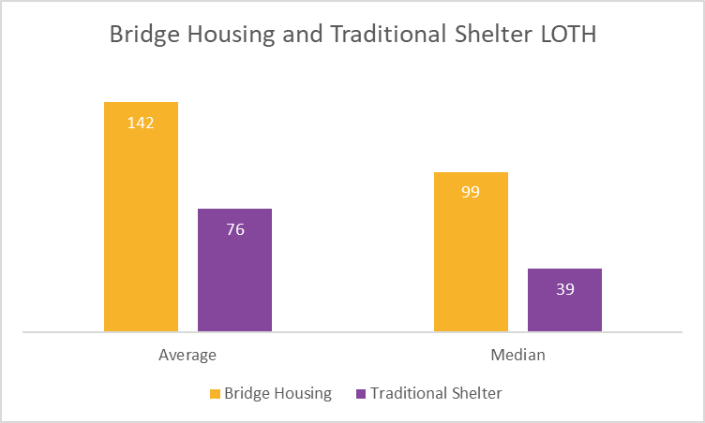
Measure 1A: Length of Time Homeless
Bridge Housing or Non-congregate shelters operate by providing hotel vouchers. Hotel vouchers are a safe, low-barrier option to shelter. Typically, our community utilizes this resource for people who qualify for a housing program such as Rapid ReHousing (RRH) or Permanent Supportive Housing (PSH).
This population has high barriers that would otherwise prevent them from accessing traditional shelter options, such as a larger family size, pets, substance use problems, and/or criminal histories.
Notes:
Presenter: Brittney
Next Slide: Brittney

Slide 21
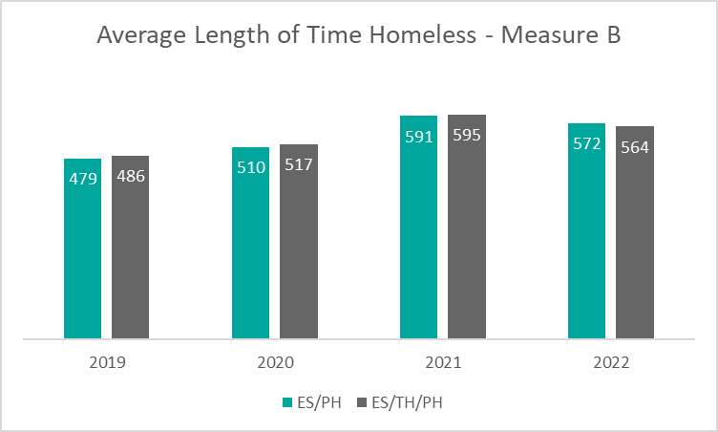
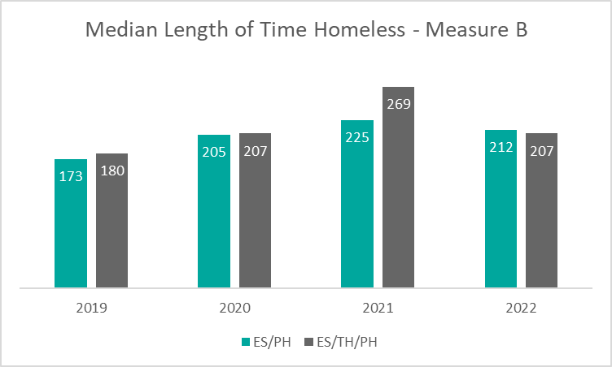
Measure 1B: Length of Time Homeless
Length of time homeless, as measured by the Approximate Date Homeless and based on self-report, decreased overall.
In particular, the median length of time homeless in Emergency Shelter, Transitional Housing, and Permanent Housing projects decreased by over 60 days.
Decreases are largely attributed to better quality data collection in ClientTrack.
Notes:
Presenter: Brittney
Next Slide: Brittney

Slide 22
Returns to Homelessness
The percentage of people who return to homelessness within two years, after exiting to a permanent housing destination.
Notes:
This measures clients who exited SO, ES, TH, SH or PH to a permanent housing destination in the date range two years prior to the report date range.
Of those clients, the measure reports on how many of them returned to homelessness as indicated in the HMIS for up to two years after their initial exit.

Slide 23
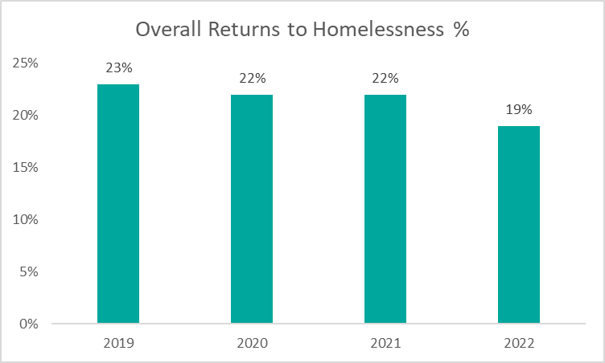
Measure 2: Returns to Homelessness
The overall percentage rate of returns to homelessness decreased by 3% in 2022.
The majority of returns to homelessness occur in Emergency Shelter (ES) projects. The least number of returns to homelessness are reported in Street Outreach (SO) projects.
Notes:
Presenter: Brittney
Next Slide: Brittney

Slide 24
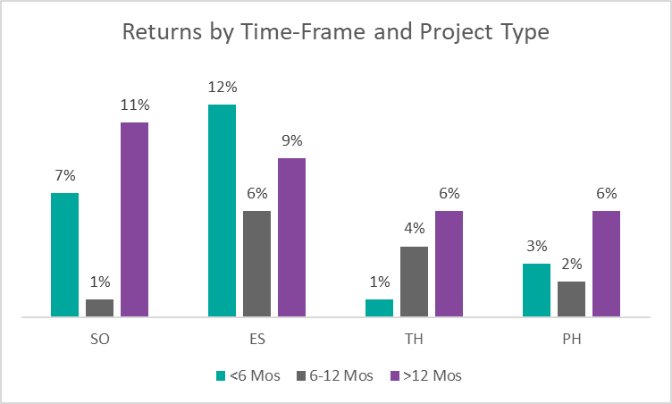
Measure 2: Returns to Homelessness
Most returns to homelessness occur either in the first 6 months after a positive exit, or 12-24 months after a positive exit.
Project types differ on the most common return timeframe. Emergency Shelter (ES) projects record more returns to homelessness in the first 6 months after a positive exit, while Permanent Housing (PH) projects report more returns in the 12-24 mo range.

Slide 25
Number of People Homeless
The number of people experiencing homelessness in Emergency Shelter and Transitional Housing projects annually.
Notes:
This measures the change in PIT counts of sheltered and unsheltered homeless person as reported on the PIT (not from HMIS). If a CoC did not conduct an unsheltered count in a particular FY, then the next-most recent unsheltered data are used.
This measures also the change in annual counts of sheltered homeless persons in HMIS.

Slide 26
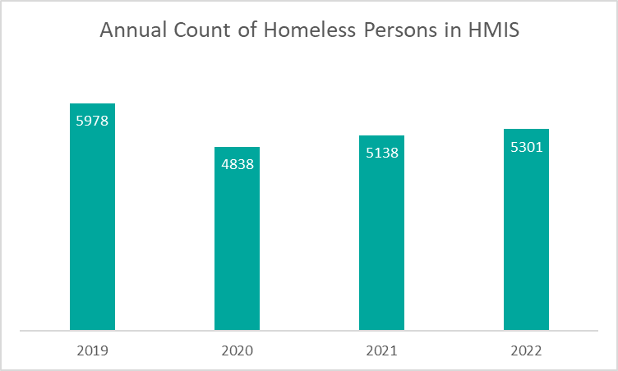
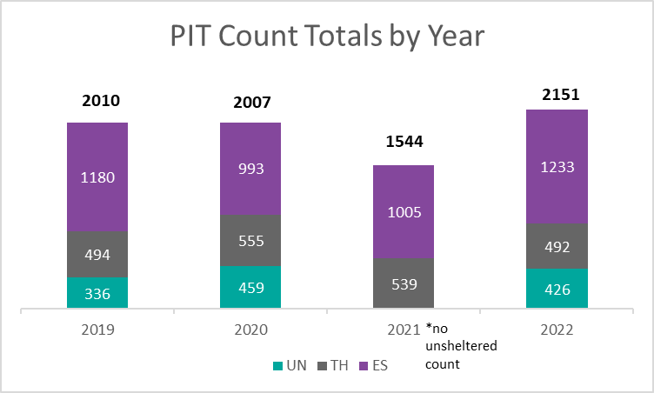
Measure 3: Number of Homeless Persons
The overall number of homeless persons in Emergency Shelter(ES) and Transitional Housing(TH) increased by 163 in 2022, but is still well below pre-pandemic levels.
The 2022 PIT count identified 2151 homeless persons in Emergency Shelter (ES), Transitional Housing (TH), and Unsheltered (UN) on the streets. This is an increase from prior years.
Notes:
Presenter: Brittney
Next Slide: Brittney

Slide 27
Employment and Income Growth
The percentage of people who increase their income while enrolled in a Rapid ReHousing or Permanent Supportive Housing project.
Notes:
This measures the change in employment and non-employment related increases in income for CoC-Funded projects.
Projects include: HUD-funded PSH and RRH, and Covenant House - TH

Slide 28
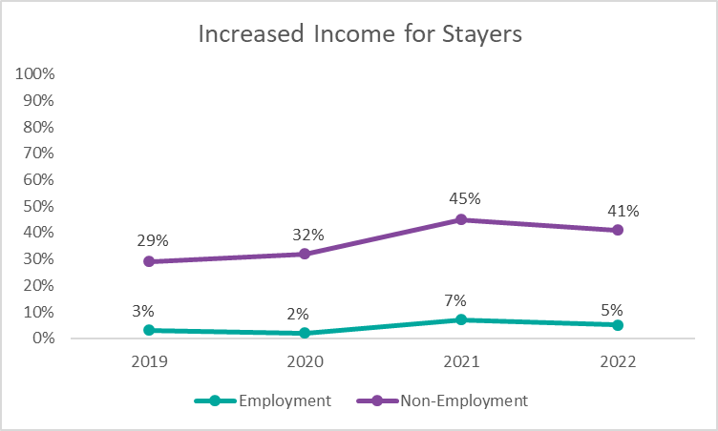
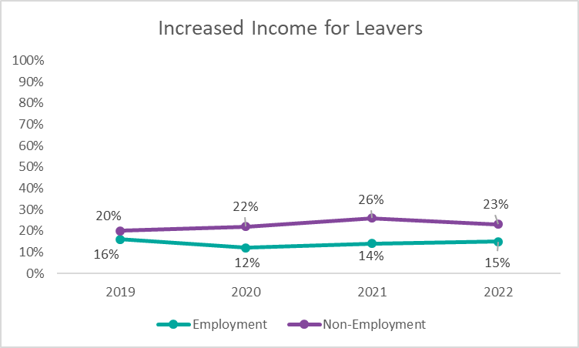
Measure 4: Increases in Income
Overall, income increases for people enrolled in CoC-Funded housing programs decreased slightly.
Total Number of People with Increased Income:
Employment (Stayers): 30
Employment (Leavers): 31
Non-employment (Stayers): 232
Non-employment (Leavers): 47

Slide 29
Number of People First-Time Homeless
The number of people who experienced homelessness for the first time (meaning they did not have any HMIS system engagement for at least two years prior).
Notes:
This measures the number of people entering the homeless system through ES, SH, TH, or PH and determines whether they have any prior enrollments in the HMIS over the past two years. Those with no prior enrollments are considered to be experiencing homelessness for the first time.

Slide 30
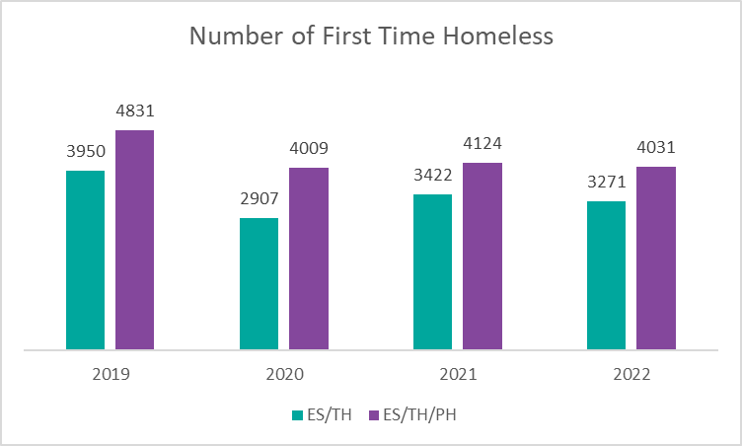
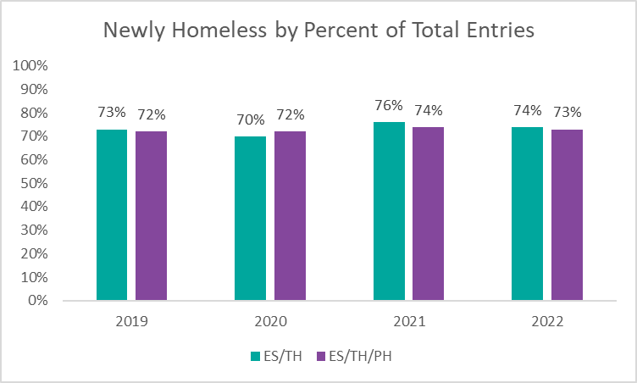
Measure 5: Number of Persons who Become Homeless for the First Time
The number of persons experiencing homelessness for the first time decreased in 2022 by ~100 persons.
As a proportion of total enrollments in Emergency Shelter (ES), Transitional Housing (TH), and Permanent Housing (PH) projects, people experiencing homelessness for the first time make up ¾ of the homeless population.
first time.
Notes:
Presenter: Brittney
Next Slide: Brittney

Slide 31
Permanent Housing Placement & Retention
The percentage of people who exit to positive destinations, such as movement from the streets to shelters, placement into permanent housing, or retention of a Permanent Supportive Housing placement.
Notes:
This measures positive movement out of the homeless system and is divided into three tables: movement off the streets from Street Outreach ; movement into permanent housing situations from ES, SH, TH, and RRH ; and retention or exits to permanent housing situations from PH (other than PH-RRH).

Slide 32
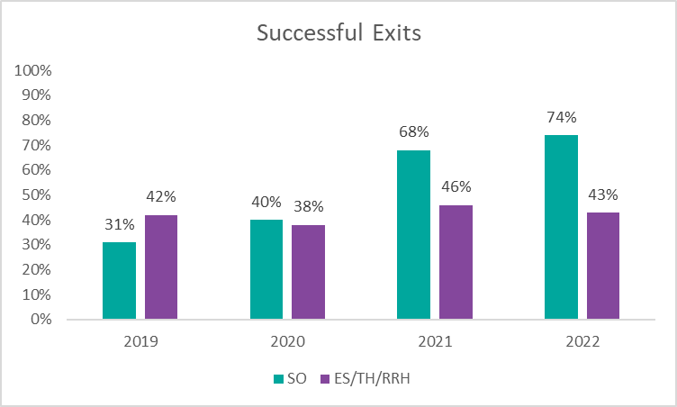
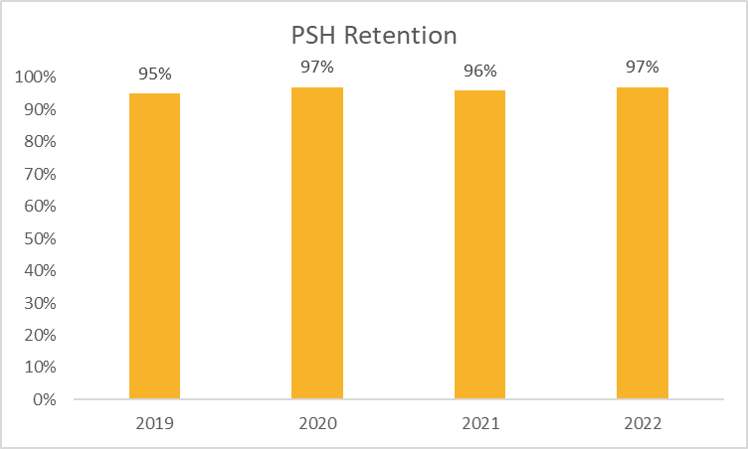
Measure 7: Permanent Housing Placement & Retention
Street Outreach (SO) projects had a positive exit rate of 74%.
42% of positive exits were to housing destinations
58% of positive exits were to temporary situations
Emergency Shelter (ES), Transitional Housing (TH), and Rapid ReHousing (RRH) projects had a positive exit rate of 43%.
97% of persons housed in Permanent Supportive Housing (PSH) projects retained their permanent housing or moved into other permanent housing.
Notes:
Presenter: Brittney
Next Slide: Racquel

Slide 33
Data Quality
For SPMs, Data Quality is measured by the amount of exit destinations that are “unknown” or cannot be calculated due to errors. Low error rate means higher Data Quality.

Slide 34
Data Quality 2018-2021
2022 Total Exit Destination Errors:
Emergency Shelter (ES): 365
Transitional Housing (TH): 37
Rapid Rehousing (RRH): 102
Permanent Housing Housing (PSH): 14
Street Outreach (SO): 131
 | 2019 | 2020 | 2021 | 2022
ES | 12% | 11% | 8% | 9%
TH | 7% | 13% | 8% | 10%
RRH | 5% | 4% | 4% | 6%
PSH | 10% | 4% | 16% | 12%
SO | 41% | 4% | 6% | 11%

Slide 35
HSN University Training
The new, self-guided virtual HMIS 101 course in HSN University was officially launched on February 6th, 2023.
To date, we have already had 12 successful course completions and more in progress right now!
No more waiting for 1st and 3rd Tuesday to train
Audio and visual support all throughout
Complete conveniently on your own schedule
Live support available
Zoom room open 1st and 3rd Tuesdays, as well as live support hours on Mon/Wed; Quick ticket response time
Live training still able to be scheduled as needed
Access to the live system provided 1-3 business days after requirements are met.
Requirements include:
Completion of all required course modules;
Demonstration knowledge in the practical portion of the training by completing required tasks/workflows in the HMIS training site;
Review, sign and submit the HMIS User Agreement
Notes:
Presenter: Racquel & Tyler
Next Slide: Racquel

Slide 36
HMIS Training & Support
Our routine monthly training calendar:
1st & 3rd Tuesday: HMIS 101 New User Training (9a - 2p)
2nd & 4th Wednesday: HMIS 101/102 Refreshers (2p - 4p)
3rd Tuesday: ClientTrack Introduction to Reports Training (3p - 4:30p)
1st Thursday: Everyday Reporting in ClientTrack (10a - 11:30a) NEW
3rd Thursday: APR/CAPER in ClientTrack (10a - 11:30a)
Data Quality Workshops
Monthly Session: 3rd Thursdays (1:30p - 3p)
* Additional training sessions may be requested as needed.
Join us for our office hours M/W from 1p - 2p for additional one-on-one HMIS support.
Reminders:
All new user training requests must come through the Agency Liaison.
Agency Liaison needs to let the HMIS team know ASAP when someone leaves
the agency so we can inactivate accounts. This is to protect the system and keep an accurate count of available subscriptions for assignment.
Notes:
Presenter: Racquel
Next Slide: Raquel

Slide 37
HMIS Data Quality Monitoring
What to expect?
Data Quality Monitors Scheduled for 2023
Communicated via agency liaisons
Primarily focuses on the CoC APR
We are looking at Q2 for FY22-23 (Jan - March)
Supportive Service Only (SSO) project will now be reviewed as well.
Recommendations for improvements and a timeline for addressing data quality issues
Follow up with a scorecard (grading system)
Quarter 2 DQMs will be scheduled this month.
Interested in sitting in on a DQM? Let us know at hmis@hsncfl.org!
Notes:
Presenter: Racquel
Next Slide: Ashley

Slide 38
Proposed changes to the Data Quality Plan (DQP)
Currently data quality reports are pulled monthly and grades are calculated for each month
12 months of grades evaluated each year
Review 3 months at a time in Data Quality Scorecards quarterly during Data Quality Monitors (DQMs)
~190 reports evaluated per month (~580 per quarter)
Propose to pull data quality reports and calculate data quality scores once per quarter
4 quarters of grades evaluated each year
Review one quarter at a time in Data Quality Scorecards during quarterly during DQMs
~190 reports evaluated per quarter
Notes:
Presenter: Ashley
Next Slide: Ashley

Slide 39
Proposed changes to the Data Quality Plan (DQP)
Currently send out calendar invites to each agency liaison to schedule a one hour DQM once per quarter
60+ agencies
Free to schedule for any available time slot within allotted 30-day window
Propose to send targeted DQM invites to only those agencies who need data quality follow-up
Only agencies who have consistently failing grades, lack of communication, or special circumstances will be sent an invite to DQM (~10 agencies per quarter)
Agencies that fail to attend DQMs (with invite) will be placed on Data Quality Improvement Plan (DQIP)
Agencies not invited to DQMs will still receive scorecards and can choose to follow up in a DQM interim meeting (outside of 30-day window)
Notes:
Presenter: Ashley
Next Slide: Ashley

Slide 40
Proposed changes to the Data Quality Plan (DQP)
Why these sudden changes?
TIME!
Shifting responsibility of monthly monitoring back to agencies
Adherence to encouragements/enforcements guidelines in Data Quality Plan (DQIP)
Thoughts?
Notes:
Presenter: Ashley
Next Slide: Angel

Slide 41
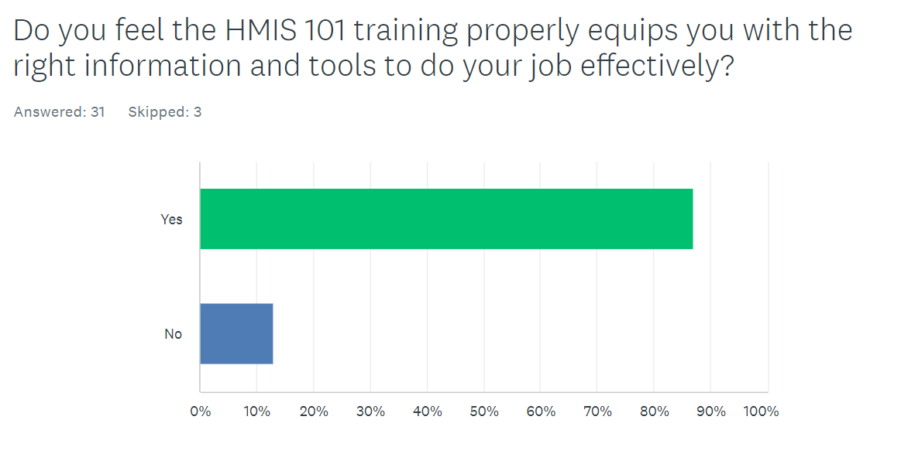
HMIS Feedback Survey Results
Respondents who answered “No” commented that training: “...is not specific to the program/hired position.”
“...was helpful on how to use the system and deal with clients but not the actual paperwork.”
Notes:
Presenter: Angel
Next Slide: Angel

Slide 42
HMIS Feedback Survey Results
What are some areas in ClientTrack where things could be better?
“Case notes: Continue with draft option button- this really helps since Client track logs you off if idled…”
“Enrollment process should be specific to the programs to avoid errors or missed steps”
“having to add each service separately”
“Adding client identifier on case notes (i.e. ID #), ability to modify an enrollment instead [of] removing and recreating a new enrollment under the wrong project”
Notes:
Presenter: Angel
Next Slide: Angel

Slide 43
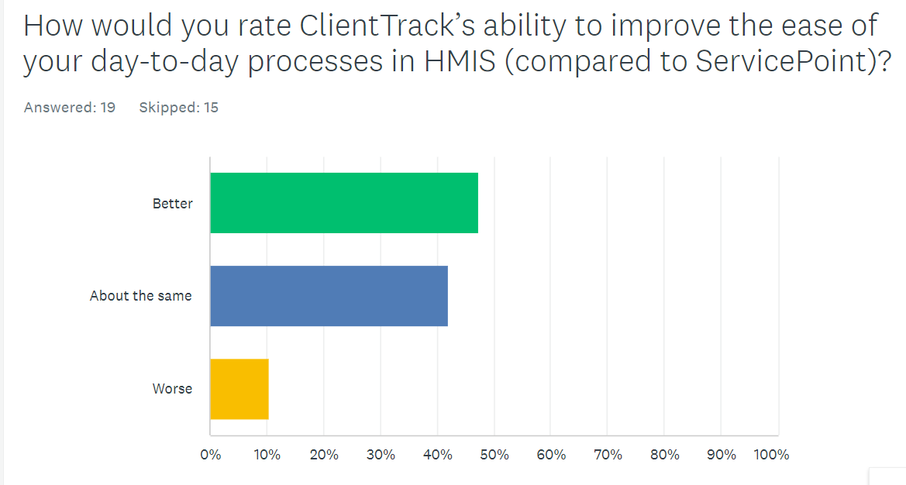
HMIS Feedback Survey Results
What are some areas in ClientTrack that are going well?
“how the site is designed and how you cannot move on until page is completed”
“Easier to use than Service Point”
“Searching for a client, inputting case notes and services”
“The ease of exiting an enrollment for a client.”
Notes:
Presenter: Angel
Next Slide: Chuck

Slide 44
HMIS Governance Updates
Identified high level procedures for HMIS Lead Agency
Updates to improve consistency/language between documents
Most updates resolve differences between documents regarding ROI usage (one ROI per client for the CoC)
HMIS Policies & Procedures
HMIS Security Plan
HMIS Privacy Plan, Privacy Poster and ROI form
HMIS Partner Agreement
HMIS End User Agreement
All documents reviewed and approved by HUD TAs
HMIS Policies, Security and Privacy Plans to be submitted to CoC Board for approval
Completed documents to be posted to HMIS website following Board approval.
HMIS Monitoring Plan is currently being updated
Notes:
Presenter: Chuck
Next Slide: Wyatt

Slide 45
Committee Roll-Call Vote
HMIS Committee Officers
Notes:
Presenter: Wyatt
Next Slide: Wyatt

Slide 46
Committee Roll-Call Vote
Any other motion before committee
Notes:
Presenter: Wyatt -Open to motions by committee members
Next Slide: Wyatt

Slide 47
HMIS Advisory Committee Nominees
Accepting nominations (from supervisors, liaisons, peers, and self)
Email hmis-advisory@hsncfl.org
Include
Name
Agency
Role with HMIS
How long you have worked in HMIS
Contact Email
Contact Telephone Number
Brief Biography
Voting on nominations will be done virtually
Please be sure that any person nominated is able to commit time to the committee and is willing to participate
Notes:
Presenter: Wyatt
Next Slide: Wyatt

Slide 48
HSN HMIS Team
Angel Jones
HMIS Operations Manager
Agustin “Tino” Paz
HMIS Senior Data Analyst
Ashley Brozenske
HMIS Data Analyst I
Brittney Behr
HMIS Project Coordinator
Chuck Vroman
HMIS System Success Specialist
Racquel McGlashen
HMIS Partner Success Specialist
Tyler Claitt
HMIS Partner Support Specialist

Slide 49
Thank you for Attending!
Next meeting date:
Tuesday, May 9th, 2023
10:30 am to 12:00 pm
HMIS Guides, Documents, Training, Acronyms & More
hmiscfl.org
https://www.hmiscfl.org/training/datadefinitions/
Notes:
Wyatt Closes Meeting

