Slide 1
HMIS Advisory
Committee Meeting
Central Florida Commission on Homelessness (CFCH)
CoC FL-507
March 12th, 2024
Brad Sefter, Committee Chair
Notes:
Call to order: Brad -All in attendance verify name, add agency
Next slide: Brad (agenda)

Slide 2
HMIS Advisory Committee Mission
HMIS Advisory Committee Purpose
Our mission is to effectively use data, which includes inputs from those in need of services, those providing services, and from members of the community, to eliminate homelessness in Central Florida.
Oversee the CoC’s implementation of HMIS, what we do with the data and how we use it.
Notes:
Presenter: Brad
Next Slide: Brad

Slide 3
HMIS Advisory Committee
Chair | Brad Sefter | Health Care Center for the Homeless
Vice Chair | Danielle Landaal | IDignity
Secretary/Recorder
Voting Member | Tracy Dale | Catholic Charities
Voting Member | Corey Berg | Family Promise of Greater Orlando
Voting Member | Keisha Thomas | The Sharing Center
Voting Member | Deborah Del Moral | The Sharing Center
Voting Member
HMIS Team Liaison | Brittney Behr | HSN - HMIS Project Coordinator
Notes:
Presenter: Brad -Committee Roll Call
Next Slide: Brad (Agenda Roll Call)

Slide 4
Agenda
Welcome - Icebreaker Activity (Kahoot!)
Call to Order
Committee Roll Call
Approval - Minutes from Jan 9th, 2023
Voice Vote - Agenda for March 12th, 2023
HMIS Team Reports:
Data Quality Plan Updates
Overview of Q1 Data Quality
SPM Submission Review
Deep Dive: Auto-Exit Feature
Referrals: Needs Submissions from Providers
COMMITTEE VOTE - All motions before committee
Notes:
Presenter: Brad -Agenda Roll Call Vote (meeting minutes from last meeting uploaded here: https://www.hmiscfl.org/hmis-advisory-committee-2/)
Next: Rocky

Slide 5
Join at www.kahoot.it
Notes:
Presenter: Rocky (will screenshare)
Next: Brad

Slide 6
Officer Reports
Data Quality Plan Updates - Ashley Brozenske
Overview of Q1 Data Quality - Ashley Brozenske
SPM Submission Review - Ashley Brozenske
Deep Dive: Auto-Exit Feature - Angel Jones
Referrals: Needs Submissions from Providers - Angel Jones
HMIS Training Updates - Racquel McGlashen
Notes:
Presenter: Brad
Next Slide: Ashley

Slide 7
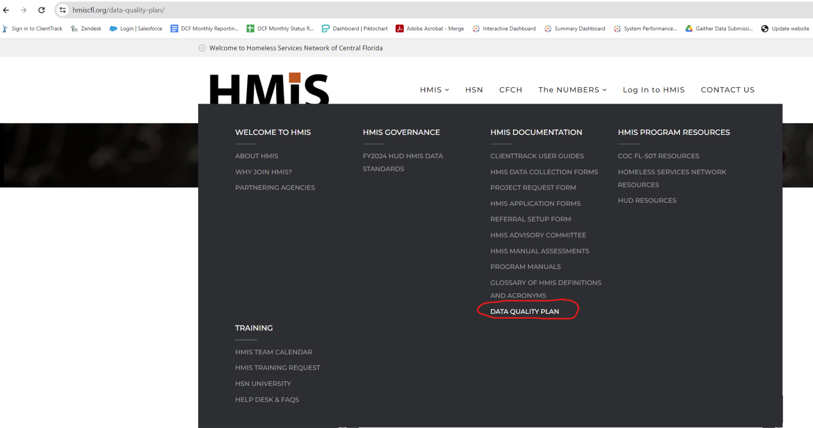
Data Quality Plan Updates
The 2023-2024 Data Quality Plan is available on our website!
https://www.hmiscfl.org/data-quality-plan/
Notes:
Presenter: Ashley
Next Slide: Ashley

Slide 8
Data Quality Plan Updates
Changes include:
Race and Ethnicity have been combined to accommodate HUD Data Standards Updates.
Monthly monitoring has been reduced to quarterly.
Consistency (user log-in review) is automated rather than being pulled monthly.
Projects with the Auto-Exit feature will not be evaluated for Income at Exit. SSO projects with the Auto-Exit feature will not be evaluated for Exit Destination.
Notes:
Presenter: Ashley
Next Slide: Ashley

Slide 9
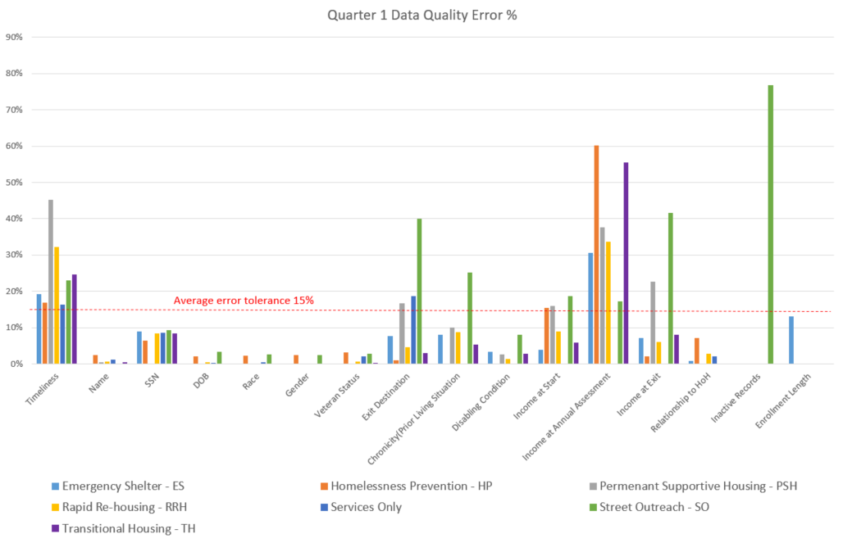
Data Quality Overview - Q1
Quarter 1 - October 2023 - December 2023
Highest error rates are for Income at Annual Assessment (average error rate is 44%). Homeless Prevention projects have the highest average error rate (60%).
Second highest error rates are for Timeliness (entering data within 3 days). The highest error rates for this data point are for Permanent Supportive Housing (45%)
Inactive records (Street Outreach only) remain high at 77% average error over all SO projects.
Notes:
Presenter: Ashley
Next Slide: Ashley

Slide 10
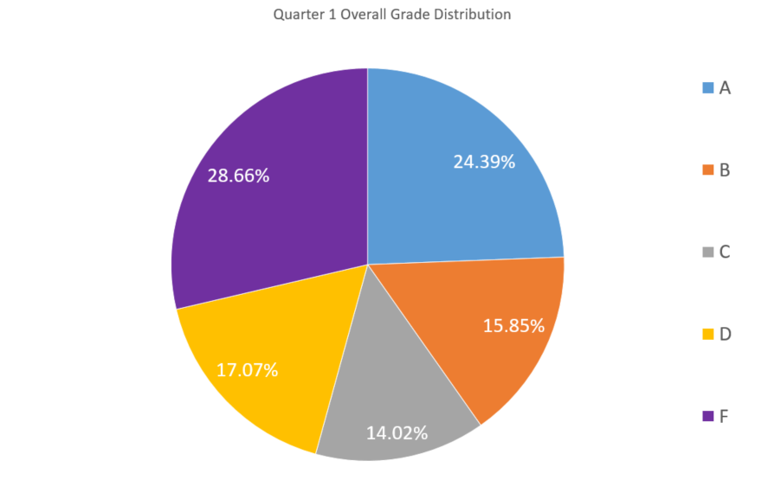
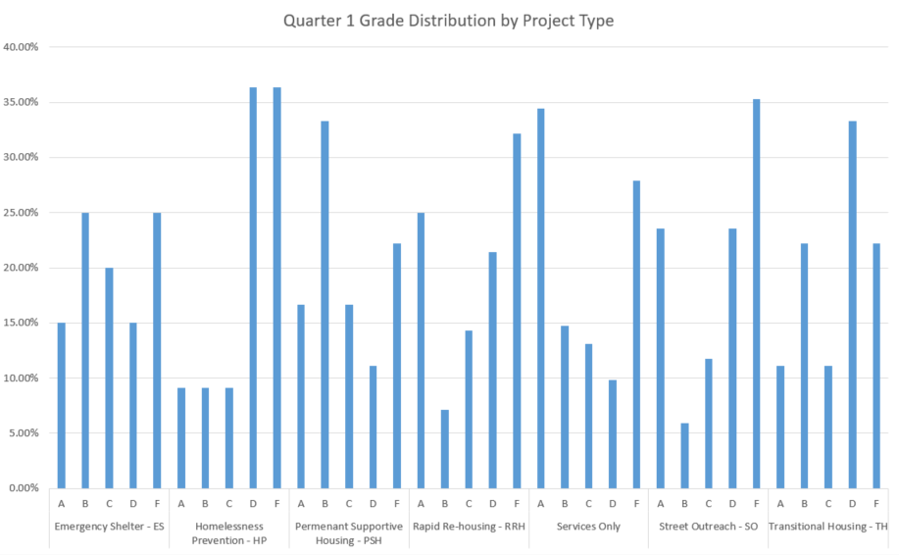
Data Quality Overview - Q1
The largest percentage of grades in the Q1 DQP are F’s (28.66%) and A’s (24.39%).
The project type with the highest percentage of failing grades is HP (almost 75% of projects are failing overall).
Services Only projects have the highest percentage of A’s (34.43%).
Agencies with the highest Data Quality scores are Family Promise, Park Place Behavioral Health Care, Recovery House, Rescue Outreach Mission, Seminole County, Transition House, and Wayne Densch
Notes:
Presenter: Ashley
Next Slide: Ashley

Slide 11
Reporting Season Updates
1/17/2024
Longitudinal Systems Analysis (LSA)
LSA Data Points: Relationship to HoH Date of Birth Move-in Date Close Inactive Projects
The LSA includes a 3-year lookback of system-level data that can be filtered by demographics and system pathways. It gives a high-level understanding of a system’s response to homelessness. Stella-P uses LSA data to generate charts. View last year’s submission here on our website)
3/13/2024
System Performance Measures (SPMs)
SPM Data Points: Annual Assessments
Move-in Date
Exit Destination
SPMs are a series of 6 metrics used to evaluate effectiveness of a homeless response system. SPMs include: length of time homeless, first-time homeless, total homeless, exits to permanent housing, returns to homelessness, and income growth. View last year’s submission here on our website
4/30/2024
Point-in-Time Count (PIT)
PIT Data Points: Relationship to HoH
Date of Birth
Race, Gender, Vet Status
Enrollments
The PIT count is an annual survey of people experiencing homelessness in our service area on a single night (the actual count can be performed over multiple days). PIT data includes people in emergency shelters and transitional housing, as well as people engaged on the streets or in another unsheltered location. View last year’s submission here on our website
4/30/2024
Housing Inventory Chart (HIC)
HIC Data Points: Total Beds
Total Units
Household Types
The HIC is a count of inventory for projects that provide housing or lodging, including ES, TH, RRH, PSH and OPH projects. This is used along with the PIT to determine utilization of a homeless response systems dedicated resources. This data is updated once a year prior to submitting. View last year’s submission here on our website
Notes:
Presenter: Ashley
Next Slide: Ashley

Slide 12
SPM Submission
What Are System Performance Measures?
System Performance Measures (SPMs) are a selection of metrics used to evaluate system-level performance
SPMs encourage communities to coordinate efforts across different projects and funding sources
SPMs are reported to HUD and are a competitive element in CoC Program Competitions for additional funding (NOFO)
SPMs focus primarily on how the whole CoC is performing, as opposed to specific projects or jurisdictions
Notes:
Presenter: Ashley
Next Slide: Ashley

Slide 13
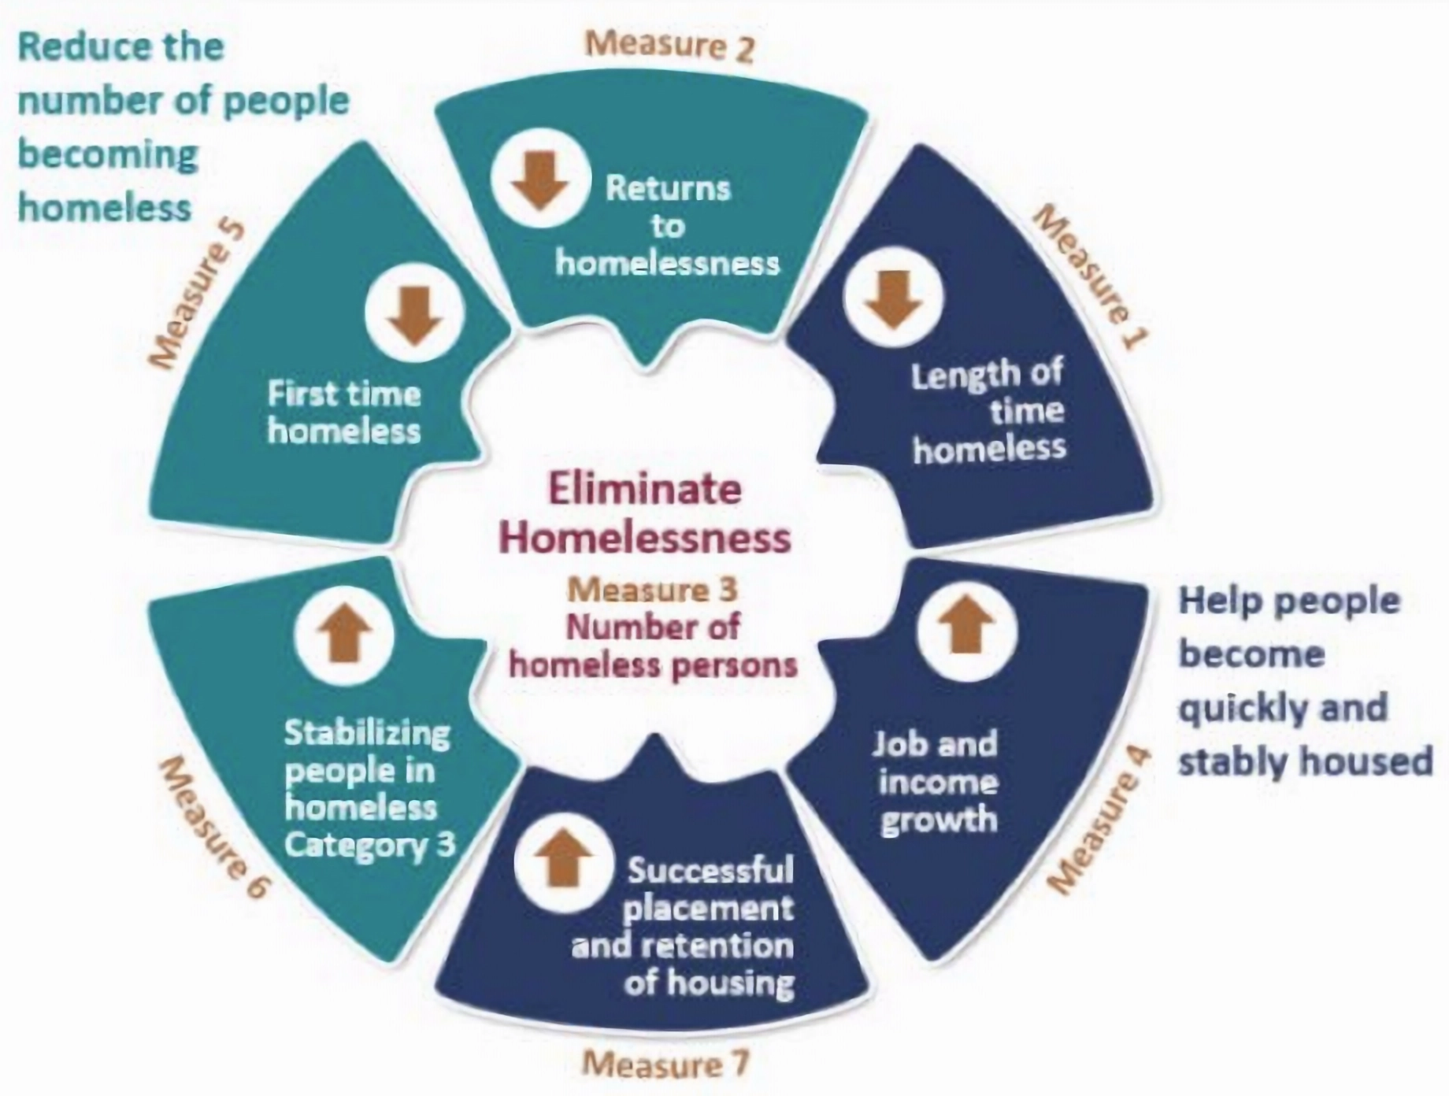
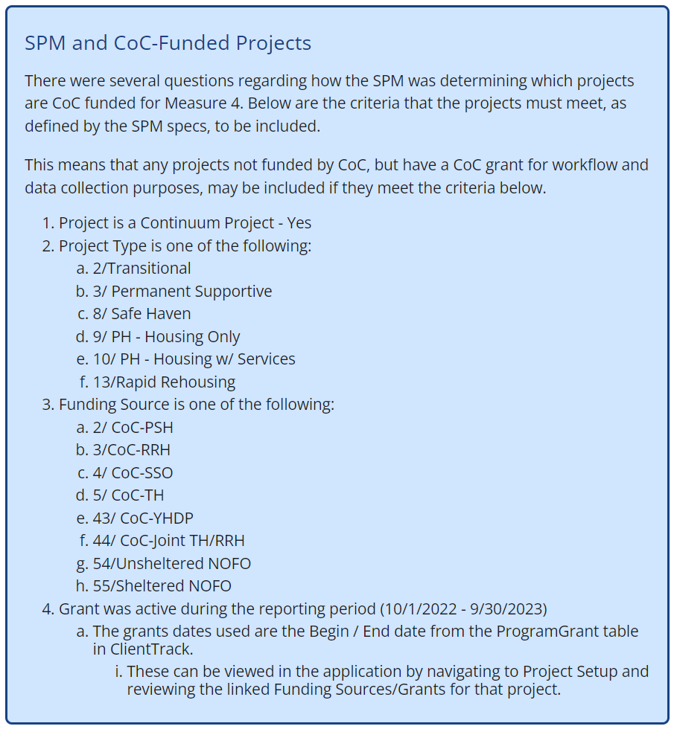
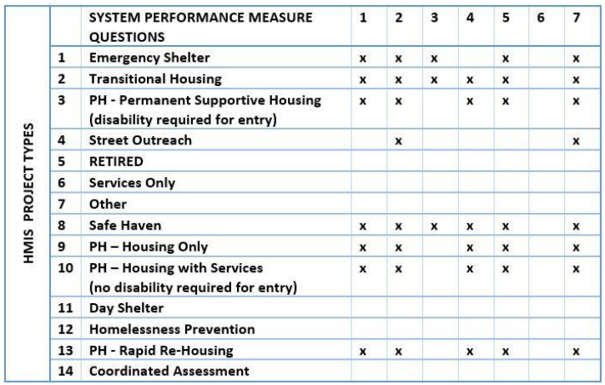
SPM Overview
Report due: March 13, 2024
Report Dates: October 1, 2022 - September 30, 2023
Notes:
Presenter: Ashley
Next Slide: Ashley

Slide 14
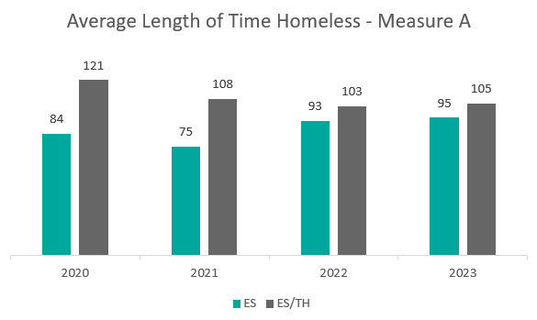
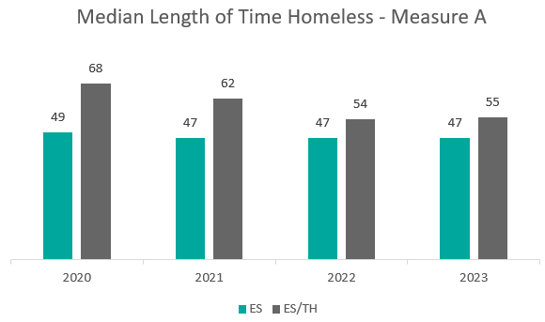
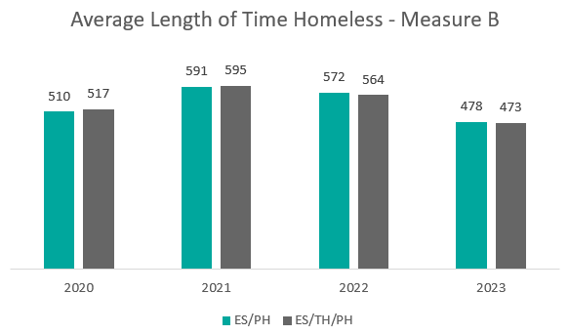
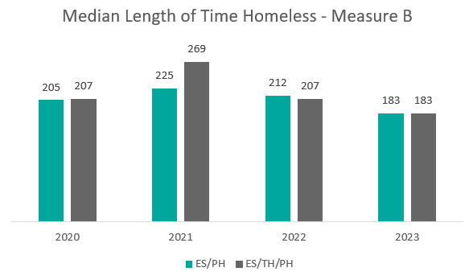
Measure 1: Length of Time Homeless
How long people experience homelessness on average, by their length of stay in Emergency Shelter and Transitional Housing projects, and by their self-reported length of time homeless.
Notes:
NOTES: Want LOT Homeless to decrease, has either decreased or stayed about the same which is good. Improves with better data quality (timely exits).
Presenter: Ashley
Next Slide: Ashley

Slide 15
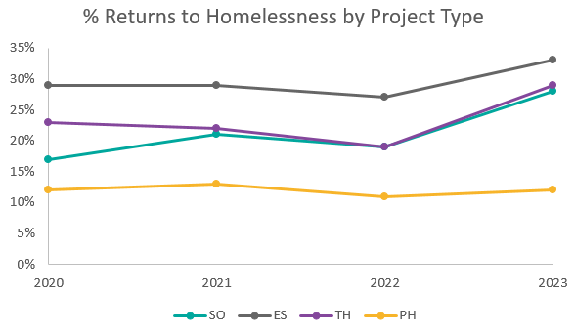
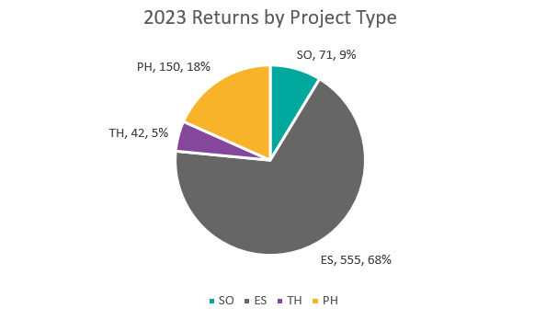
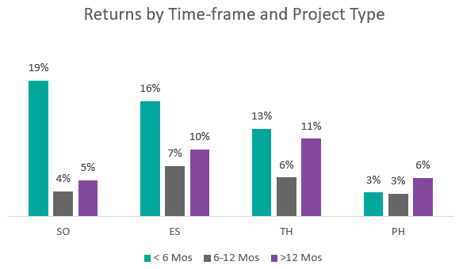
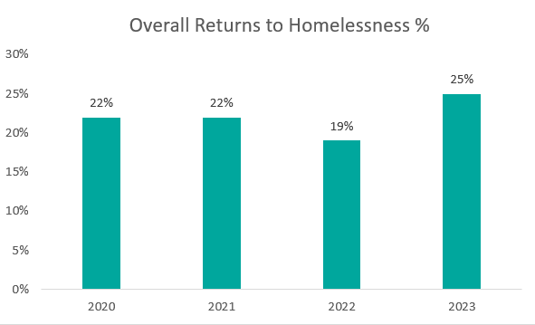
Measure 2: Returns to Homelessness
The percentage of people who return to homelessness within two years, after exiting to a permanent housing destination.
Notes:
NOTES: Want RtH to decrease, increased for all project types (highest increase for SO (9%) and TH (10%)). Important to note that these two projects have lowest denominator (42/144 for TH, 71/252 for SO, ES is 555/1668 and PH is 150/1225).
Presenter: Ashley
Next Slide: Ashley

Slide 16
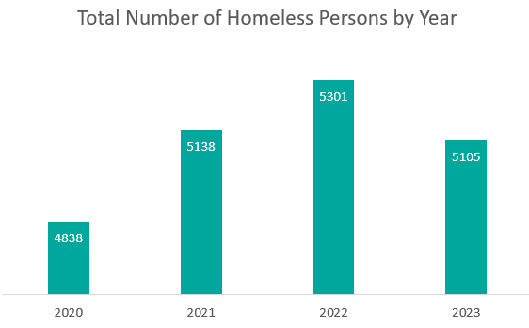
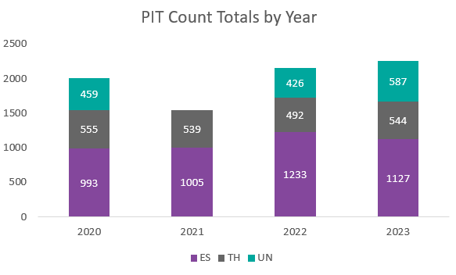
Measure 3: Number of People Homeless
The number of people experiencing homelessness in Emergency Shelter and Transitional Housing projects annually.
Notes:
NOTE: Total number of homeless persons decreased by almost 200 persons from the past year. Meanwhile PIT count data showed an increase in unsheltered persons by 161.
Presenter: Ashley
Next Slide: Ashley

Slide 17
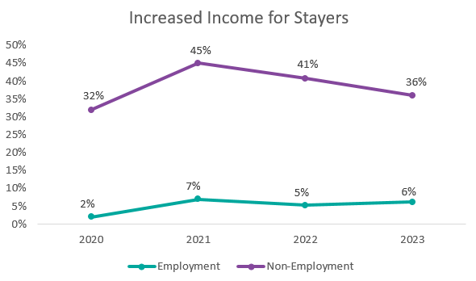
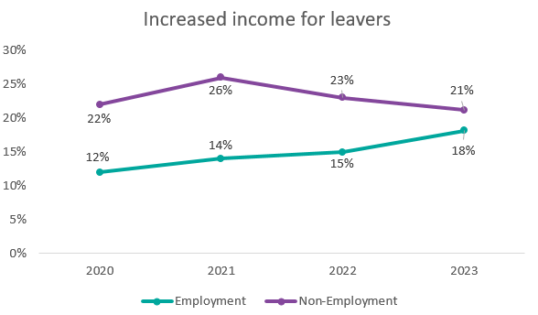
Measure 4: Employment and Income Growth
The percentage of people who increase their income while enrolled in a Rapid ReHousing or Permanent Supportive Housing project.
Notes:
NOTE: We want income to increase for individuals experiencing homelessness. The percent of persons with increased employment income increased since last year for both stayers and leavers. Non-employment income has decreased. Annual assessments are crucial for highlighting income increases.
Presenter: Ashley
Next Slide: Ashley

Slide 18
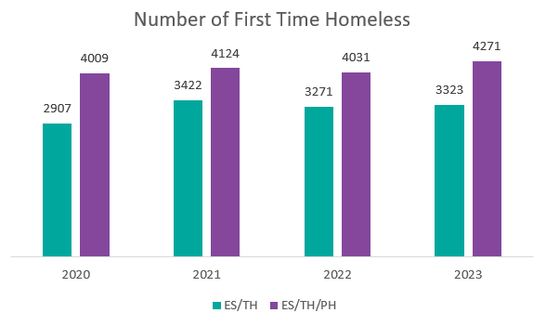
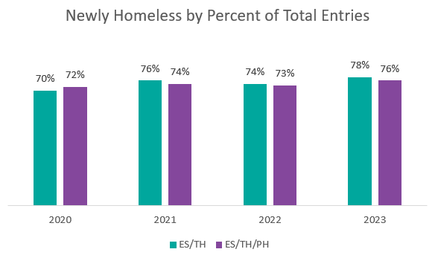
Measure 5: Number of People First-Time Homeless
The number of people who experienced homelessness for the first time (meaning they did not have any HMIS system engagement for at least two years prior).
Notes:
NOTE: We want FTH to decrease. Number of FTH has slightly increased over time.
Presenter: Ashley
Next Slide: Ashley

Slide 19
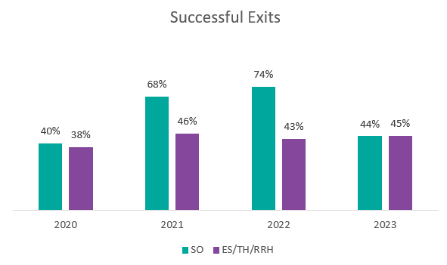
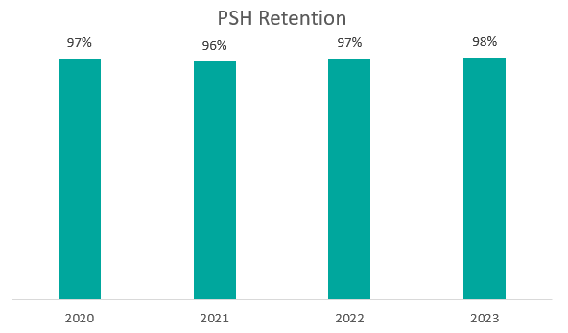
Measure 7: Permanent Housing Placement & Retention
The percentage of people who exit to positive destinations, such as movement from the streets to shelters, placement into permanent housing, or retention of a Permanent Supportive Housing placement.
Notes:
NOTE: PSH retention stayed about the same (slight increase). Successful exits increased overall but decreased significantly for SO. SO exits affected by CV funding ending.
Presenter: Ashley
Next Slide: Ashley

Slide 20
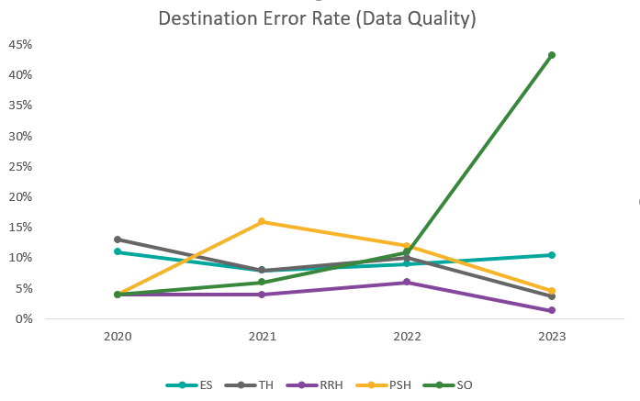
Data Quality: Exit Destination Errors
For SPMs, Data Quality is measured by the amount of exit destinations that are “unknown” or cannot be calculated due to errors. Low error rate means higher Data Quality.
2023 Destination Errors
Emergency Shelter (ES): 334
Transitional Housing (TH): 14
Permanent Supportive Housing (PSH): 10
Rapid Re-Housing (RRH): 78
Street Outreach (SO): 777*
*Large number of Street Outreach exits due to ending Covid funding and project closure.
Notes:
Presenter: Ashley
Next Slide: Ashley

Slide 21
HMIS Administrative Feature: Auto Exits
What are Auto Exits?
Auto-Exit functionality in HMIS allows the system to automatically exit a client if they have not received a qualifying service in a specified number of days. The exit date will be the date of the client’s last qualifying service or, if the client received no eligible services, the date will be the same as the enrollment date.
Qualifying services are services which, when added to the system, indicate that the client is still being served and should remain in the project (will not be auto-exited). Upon setup, these services are identified by the agency requesting the Auto-Exit feature.
Along with qualifying services, the agency also specifies the number of days the system waits before enacting the Auto-Exit (typically 90 days).
Additionally, the system can notify users if a client has not received a qualifying service in a specified amount of days.
Notes:
Presenter: Angel
Next Slide: Angel

Slide 22
Should you use Auto-Exits?
Pros
Helps users stay on top of client exits (especially for projects with high turnover).
Useful for projects with a high number of enrollments with overdue exits.
For Street Outreach – improves data quality for Inactive Records (clients that do not have Current Living Situation updates within 90 days).
More accurate reporting and better data quality for Annual Assessments
Cons
Only appropriate for certain project types (Emergency Shelter, Street Outreach, Other, and Support Services Only projects not linked to Permanent Housing).
Poor data quality for clients exited with Auto-Exit.
Auto-Exits go back to last qualifying service received – could exit clients many months back (affects reporting).
Notes:
Presenter: Angel
Next Slide: Angel

Slide 23
How does Auto-Exit affect Data Quality?
When a client is Auto-Exited, their Exit Destination is automatically set to “No Exit Interview Completed.”
Data Quality error for “Destination.”
No Exit Interview = No Income at Exit.
Data Quality error for “Income at Exit”
Because the Exit Date for Auto-Exited clients is set to the last day they received a qualifying service (or for those with no qualifying services, same day entry/exit) exits may be for many months (or years) in the past.
These clients will then fall off of all reports back to their exit date.
Notes:
Presenter: Angel
Next Slide: Angel

Slide 24
Scenario
Project A has 500 enrollments. In 2020 Project A held an event where they served 100 clients handing out backpacks with hygiene supplies. These clients were all enrolled into the project and a service of “Backpacks” was added. These clients received no other services and were not exited. It is now January 2024 and Project A has decided to use the Auto Exit feature. The Auto-Exit days is set to 90 days. For January and February Project A reported serving 500 clients, but in March (when the Auto-Exits take place) their report says they’re only serving 400 clients. Upon further research, they notice that the reports for January and February also show 400 clients served. What happened?
Notes:
Presenter: Angel
Next Slide: Angel

Slide 25
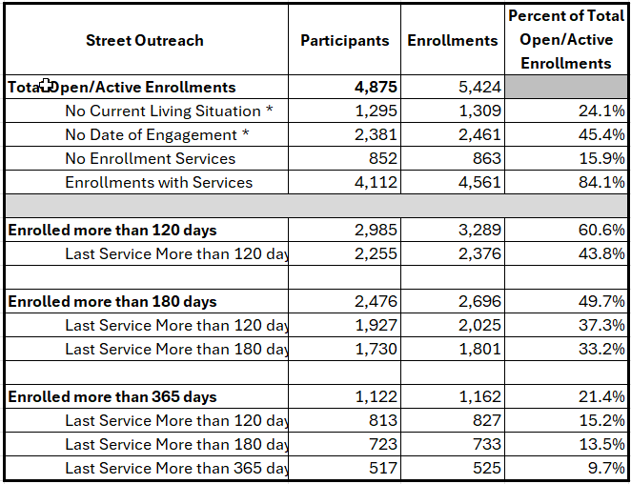
Street Outreach Open Enrollments
Notes:
Presenter: Angel
Next Slide: Angel

Slide 26
Takeaways
Auto-Exits are a great resource for projects with high turnover who may find it difficult to keep up with client exits.
Auto-Exits can also be a great tool for Street Outreach projects to keep track of when clients “go missing.”
The Auto-Exit feature is not meant to replace the exercise of exiting clients when they are no longer being served.
The best practice is to exit clients when they are no longer being served. Let the Auto-Exit feature notify you when clients have not received qualifying services in X days so that you can exit them accordingly. The Auto-Exit should be the last resort to exit the client.
Auto-Exits will lower your data quality score if you let too many clients reach Auto-Exit status.
Notes:
Presenter: Angel
Next Slide: Angel

Slide 27
APR/CAPER Deep Dive Content - How to Read the Report

Slide 28
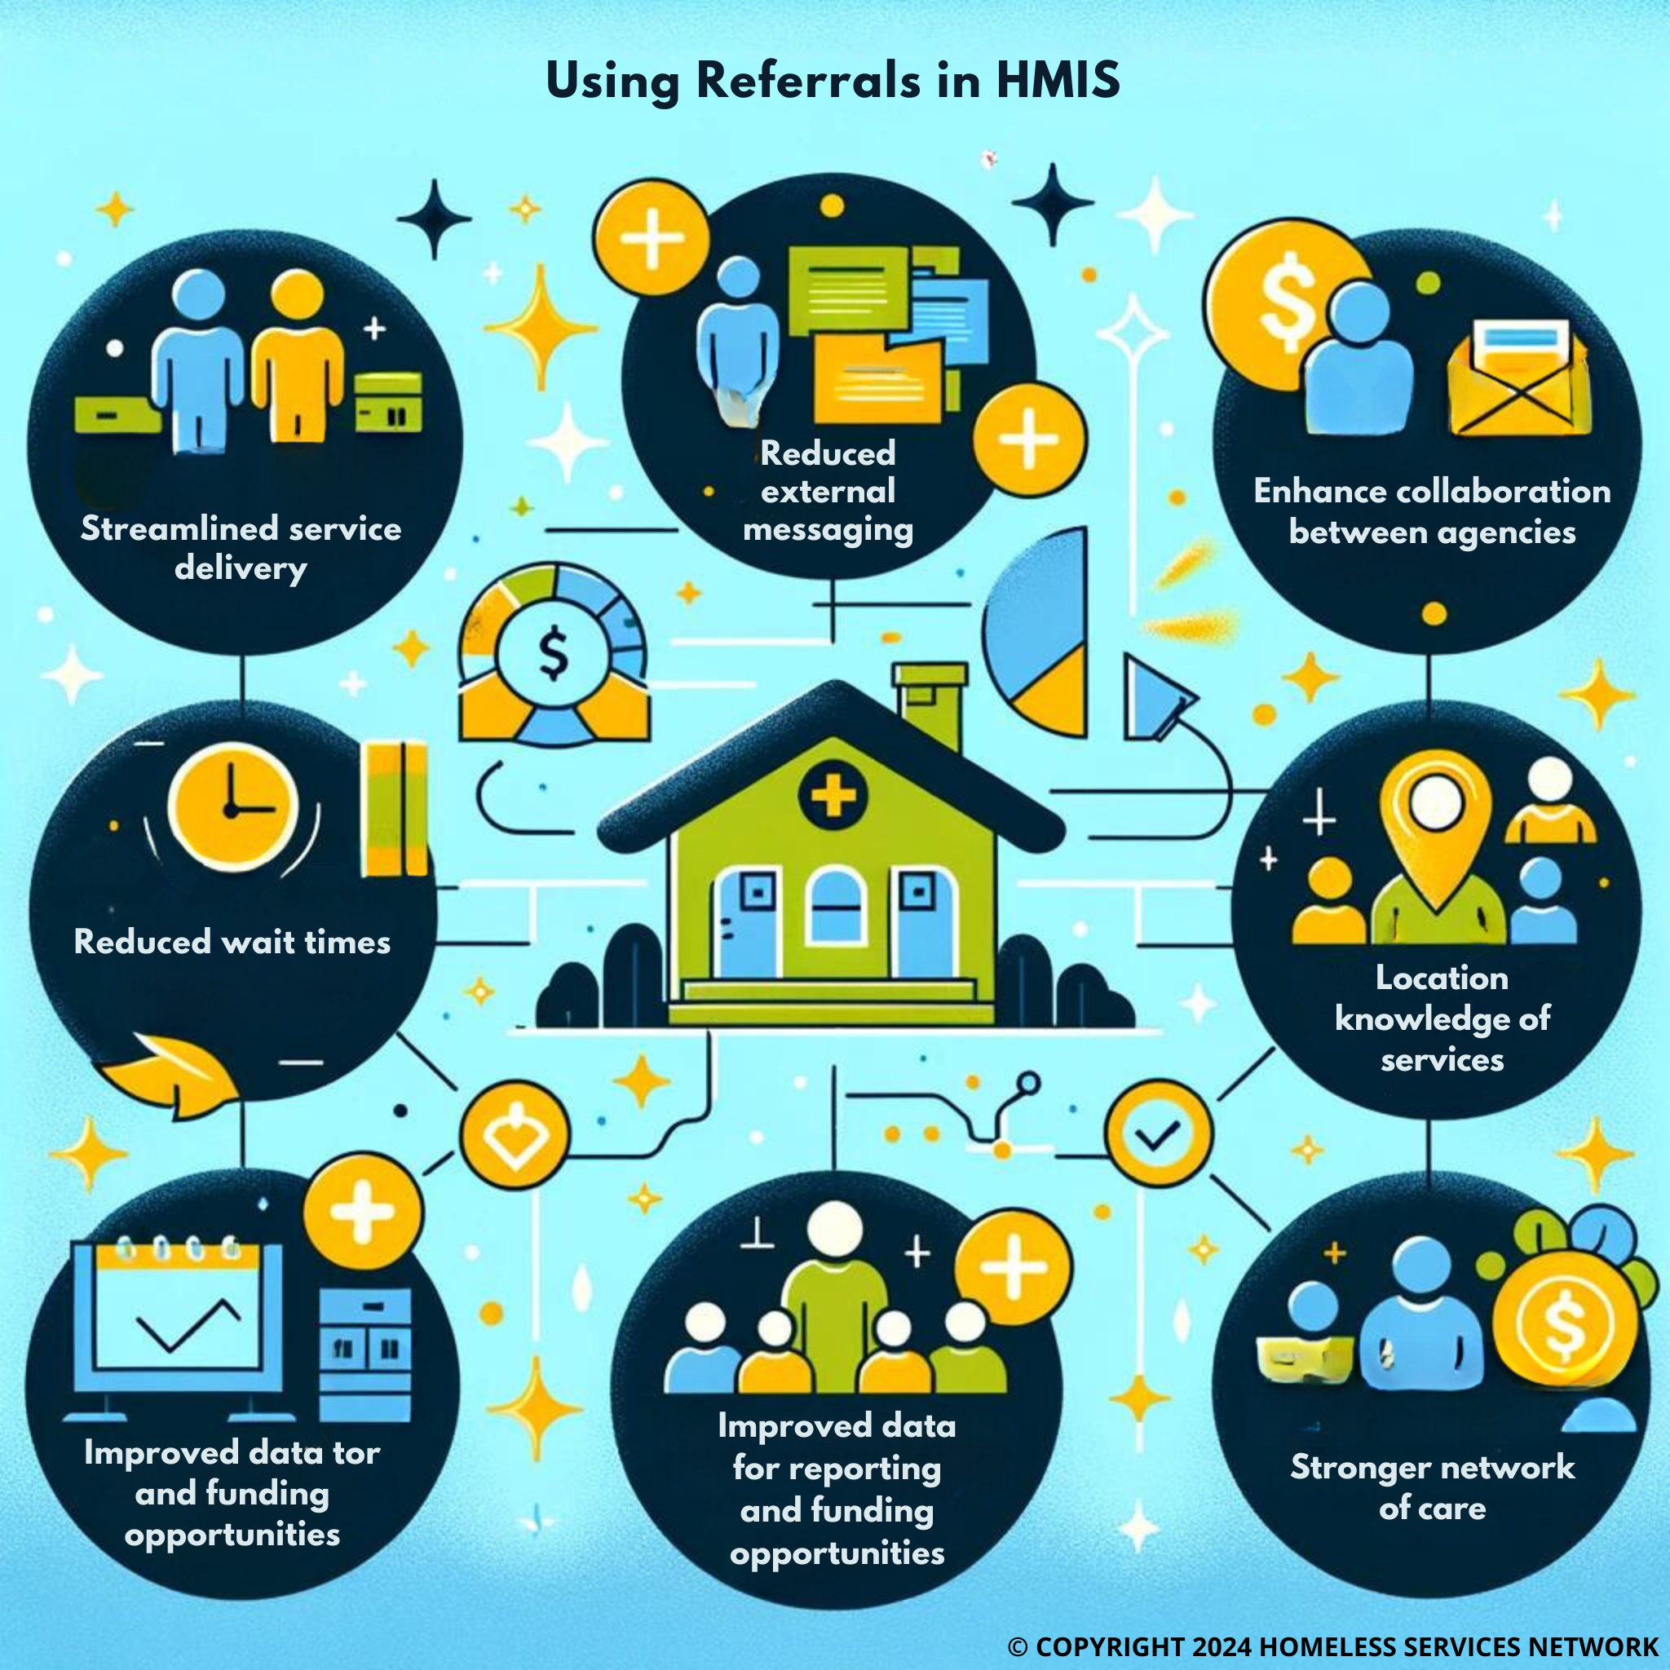
Referral Form: hmiscfl.org/referral-setup/
Notes:
Presenter: Angel
Next Slide: Rocky
Referral Form Location
hmiscfl.org/referral-setup/
Purpose: Referrals help streamline the complex process of addressing homelessness, improve the effectiveness of services, and contribute to the overall goal of reducing and preventing homelessness in communities.

Slide 29
HSN University Training
Reminder - when training requests are submitted to our team for New User training, the trainee is automatically assigned to the virtual course. This allows for your staff members to get through the training and into the live system more quickly vs waiting for the next available live training session (via Zoom).
HMIS 101 Course Requirements include:
Completion of all required course modules;
Demonstrate knowledge in the practical portion of the training by completing required tasks/workflows in the HMIS training site;
Review, sign and submit the HMIS User Agreement
Other courses available in HSN University at this time include:
HMIS 101: Refresher
HMIS 102: SSVF
New Course Available: HMIS Agency Liaison Orientation
Upcoming Virtual Courses: HMIS 102: Street Outreach & PATH
Notes:
Presenter: Racquel
Next Slide: Racquel

Slide 30
HMIS Training & Support
Our routine monthly training calendar:
1st & 3rd Tuesday: HMIS 101 New User Training (9a - 2p)
2nd & 4th Wednesday: HMIS 101/102 Refreshers (2p - 4p)
3rd Tuesday: ClientTrack Introduction to Reports Training (3p - 4:30p)
Ad-Hoc Reports Training (request via HMIS Support Ticket)
APR/CAPER in ClientTrack
Everyday Reporting in ClientTrack
Explore Data Explorer
Data Quality Workshop
Join us for our office hours M/W from 1p - 2p for additional one-on-one HMIS support.
Reminders:
All new user training requests must come through the Agency Liaison.
Agency Liaison needs to let the HMIS team know ASAP when someone leaves
the agency so we can inactivate accounts. This is to protect the system and keep an accurate count of available subscriptions for assignment.
Notes:
Presenter: Racquel
Next Slide: Racquel
Next Slide: Raquel

Slide 31
HMIS Training & Support
HMIS data collection templates are available on our website at: www.hmiscfl.org
Recommended to have hard copies on hand in the event that inclement weather results in a power outage.
Fillable templates available for all projects types and collection points
entry, exit, update and annual assessment templates
emergency shelter, transitional, rapid-rehousing, PATH, SSVF, ect.
Schedule a Live HMIS Refresher Training!
Starting this month, agencies are invited to schedule an in-person HMIS Refresher training for your HMIS users. Schedule your agency for this training at:
https://calendly.com/hmis/15min-1
Questions? Contact us at hmis@hsncfl.org
Notes:
Presenter: Racquel
Next Slide: Racquel

Slide 32
HMIS Data Quality Monitoring
We will send an invite link out at the end of the month for agencies to schedule DQMs for the second quarter of this fiscal year (Jan - March 2024). Scorecards will be sent out to all HMIS-participating agencies around the end of this month.
Providers are expected to review and clean up data as much as possible for these first two quarters of FY23-24 by the end of this month. Data cleansing helps prepare our community for reporting to HUD and other federal funders and give us an accurate picture of what is going on in our community/system.
The Agenda
For agency liaisons attending, you can expect the following items to be covered in this session:
Review of active users at your agency
Project review: any missing start/end dates, funding source(s), funding start/end dates
Project review: data quality for Jan - March 2024
We look forward to meeting with you to review your performance and progress!
Notes:
Presenter: Racquel
Next Slide: Brad
Next Slide: Ashley
Next Slide: Ashley

Slide 33
Committee Roll-Call Vote
HMIS Committee Officers
Notes:
Presenter: Brad
Next Slide: Brad

Slide 34
Committee Roll-Call Vote
Any other motion before committee
Notes:
Presenter: Brad -Open to motions by committee members
Next Slide: Brad

Slide 35
Thank you for Attending!
Next meeting date:
Tuesday, May 14th, 2024
10:30 am to 12:00 pm
HMIS Guides, Documents, Training, Acronyms & More
hmiscfl.org
https://www.hmiscfl.org/training/datadefinitions/
Notes:
Brad Closes Meeting

Slide 36
HSN HMIS Team
Angel Jones
HMIS Operations Manager
Agustin “Tino” Paz
HMIS Senior Data Analyst
Ashley Brozenske
HMIS Data Analyst I
Brittney Behr
HMIS Project Coordinator
Racquel McGlashen
HMIS Partner Success Specialist
Tyler Claitt
HMIS System Success Specialist
Tim Reed
HMIS Partner Success Specialist

