Slide 1
HMIS Advisory
Committee Meeting
Central Florida Commission on Homelessness (CFCH)
CoC FL-507
July 9th, 2024
Brad Sefter, Committee Chair
Notes:
Call to order: Brad -All in attendance verify name, add agency
Next slide: Brad (agenda)

Slide 2
HMIS Advisory Committee Mission
HMIS Advisory Committee Purpose
Our mission is to effectively use data, which includes inputs from those in need of services, those providing services, and from members of the community, to eliminate homelessness in Central Florida.
Oversee the CoC’s implementation of HMIS, what we do with the data and how we use it.
Notes:
Presenter: Brad
Next Slide: Brad

Slide 3
HMIS Advisory Committee
Chair | Brad Sefter | Health Care Center for the Homeless
Vice Chair | Danielle Landaal | IDignity
Secretary/Recorder | Danielle Landaal | IDignity
Voting Member | Tracy Dale | Catholic Charities
Voting Member | Corey Berg | Family Promise of Greater Orlando
Voting Member | Keisha Thomas | The Sharing Center
Voting Member | Deborah Del Moral | The Sharing Center
Voting Member
HMIS Team Liaison | Brittney Behr | HSN - HMIS Project Coordinator
Notes:
Presenter: Brad -Committee Roll Call
Next Slide: Brad (Agenda Roll Call)

Slide 4
Agenda
Welcome
Call to Order
Committee Roll Call
Approval - Minutes from May 14th, 2024
Voice Vote - Agenda for July 9th, 2024
HMIS Team Reports:
  HMIS Advisory Committee Voting Member Nominations
  PIT and HIC Data Available Online
  Evidence-Based Practices Workshop Reminder
  APR/CAPER Deep Dive
COMMITTEE VOTE - All motions before committee
Notes:
Presenter: Brad -Agenda Roll Call Vote (meeting minutes from last meeting uploaded here: https://www.hmiscfl.org/hmis-advisory-committee-2/)
Next: Rocky

Slide 5
Officer Reports
  HMIS Advisory Committee Voting Member Nominations – Brittney Behr
  PIT and HIC Data Available Online – Brittney Behr
  Evidence-Based Practices Workshop Reminder – Brittney Behr
  Training Updates - Racquel McGlashen
  APR/CAPER Deep Dive – Ashley Brozenske and Agustin "Tino" Paz
Notes:
Presenter: Brad
Next Slide: Ashley

Slide 6
HMIS Advisory Committee Voting Member Nominations
Accepting nominations (from supervisors, liaisons, peers, and self)
Current and former clients are eligible as well
  Email hmis-advisory@hsncfl.org
    Include:
            Name
      Agency
      Role with HMIS
      How long you have worked in HMIS
      Contact Email
      Contact Telephone Number
      Brief Biography
Voting on nominations will be done virtually
Please be sure that any person nominated is able to commit time (approximately 2-3 hours monthly) to the committee and is willing to participate
Notes:
Also mention expanded YYA can serve (cat 1, 2 and 4), and expanded eligible expenses

Slide 7
PIT/HIC Data Available Online
PIT Data Tables (including county-specific figures) can be found here.
PIT Infographic Totals can be found here.
PIT Infrographics by County can be found here:
Orange County
Osceola County
Seminole County
  Huge thanks to everyone who participated in this year's count!

Slide 8

To register:
Complete the google form here.
OR
Email Dr. Andrew Sullivan: andrew.sullivan@ucf.edu

Slide 9
HSN University Training
Reminder - when training requests are submitted to our team for New User training, the trainee is automatically assigned to the virtual course. This allows for your staff members to get through the training and into the live system more quickly vs waiting for the next available live training session (via Zoom).
HMIS 101 Course Requirements include:
  Completion of all required course modules;
  Demonstrate knowledge in the practical portion of the training by completing required tasks/workflows in the HMIS training site;
  Review, sign and submit the HMIS User Agreement
Other courses available in HSN University at this time include:
HMIS 101 New User HMIS 101: Refresher
HMIS 102: SSVF HMIS Agency Liaison Orientation
New Courses Available: HMIS 102: Street Outreach & HMIS 102: PATH
Upcoming Virtual Courses: Reporting and Data Quality in ClientTrack
Notes:
Presenter: Racquel
Next Slide: Racquel

Slide 10

HMIS Training & Support
Our routine monthly training calendar:
1st & 3rd Tuesday: HMIS 101 New User Training (9a - 2p)
2nd & 4th Wednesday: HMIS 101/102 Refreshers (2p - 4p)
3rd Tuesday: ClientTrack Introduction to Reports Training (3p - 4:30p)
Ad-Hoc Reports Training (request via HMIS Support Ticket)
APR/CAPER in ClientTrack
Everyday Reporting in ClientTrack
Explore Data Explorer
Data Quality Workshop
Join us for our office hours M/W from 1p - 2p for additional one-on-one HMIS support.
Reminders:
All new user training requests must come through the Agency Liaison.
Agency Liaison needs to let the HMIS team know ASAP when someone leaves
the agency so we can inactivate accounts. This is to protect the system and keep an accurate count of available subscriptions for assignment.
Notes:
Presenter: Racquel
Next Slide: Racquel
Next Slide: Raquel

Slide 11
HMIS Training & Support
HMIS data collection templates are available on our website at: www.hmiscfl.org
Recommended to have hard copies on hand in the event that inclement weather results in a power outage.
Fillable templates available for all projects types and collection points
  entry, exit, update and annual assessment templates
  emergency shelter, transitional, rapid-rehousing, PATH, SSVF, ect.
Schedule a Live HMIS Refresher Training!
Agencies are invited to schedule an in-person HMIS Refresher training for your HMIS users. This opportunity is now available year-round!
Schedule your agency for this training at:
https://calendly.com/hmis/15min-1
Questions? Contact us at hmis@hsncfl.org
Notes:
Presenter: Racquel
Next Slide: Racquel

Slide 12
HMIS Data Quality Monitoring
We are getting ready to schedule quarter three DQMs for this fiscal year (April - June 2024). Scorecards will be sent out to all HMIS-participating agencies by the end of this week as well as a link to schedule this session.
Providers are expected to review and clean up data as much as possible for these first three quarters of FY23-24 by the end of the month. Data cleansing helps prepare our community for reporting to HUD and other federal funders and give us an accurate picture of what is going on in our community/system.
The Agenda
For agency liaisons attending, you can expect the following items to be covered in this session:
Review of active users at your agency
Project review: any missing start/end dates, funding source(s), funding start/end dates
Project review: data quality for October 2023 – Current Date
We look forward to meeting with you to review your performance and progress! Look out for the email this week with the link to schedule a DQM for your agency.
Notes:
Presenter: Racquel
Next Slide: Brad
Next Slide: Ashley
Next Slide: Ashley

Slide 13

APR
Deep Dive
Running, Viewing, and Analyzing APR reports

Slide 14

Goals and Objectives
Learn about what the APR report is and what it's used for.
Showcase how to run and view APRs in ClientTrack.
Review the APR and how to use the data.

Slide 15

What is the APR?
The APR is a HUD Standard report which uses the most recent enrollment for active deduplicated clients during the report period (based on Start and End dates selected in the report parameters).
Table 5 of the APR provides useful summary data for enrollments such as Number of Persons Served, Number of Adult Heads of Household, and Number of Leavers/Stayers.
  Also available in Data Quality Report (in ClientTrack).

Slide 16

What is the difference between the APR and the CAPER?
CoC-APR
ESG-CAPER
Used for CoC funded projects.
27 questions.
Includes subsections for Veterans, Chronic, and Youth.
Used for RUSH, ESG and ESG-CV funded projects.
26 questions.
Same data quality sections (Q6).
Can be run by anyone for any project, regardless of their funding source.

Slide 17

What is the role of the APR in our CoC?
Used for Data Quality Monitoring (DQMs).
Required by jurisdictions with certain funding sources.
Used to monitor and understand project documentation and activity.

Slide 18
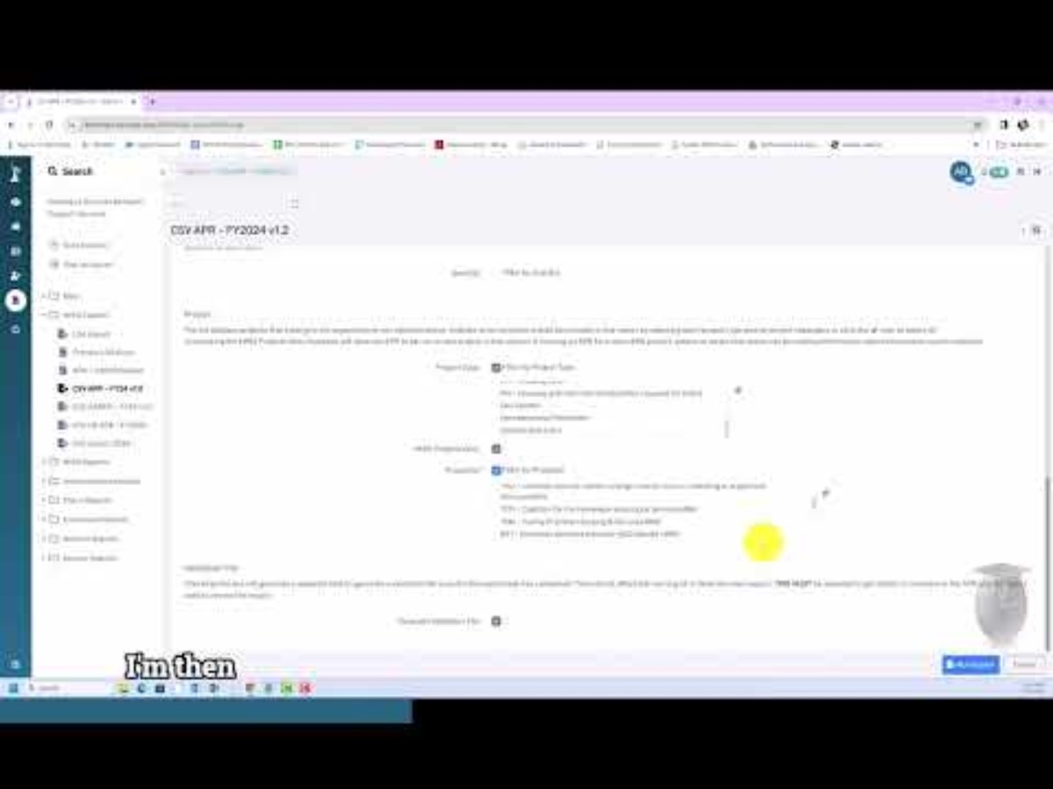

Slide 19
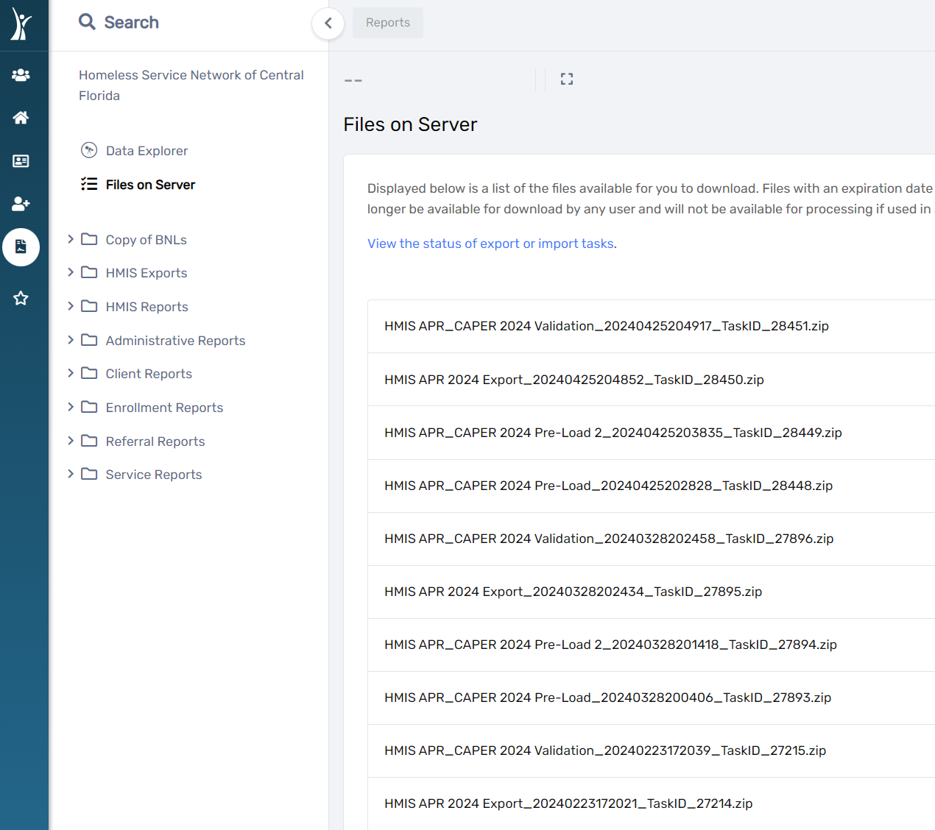
APR storage
Files on Server in ClientTrack.
Export file is used when APR is required for Sage upload.

Slide 20
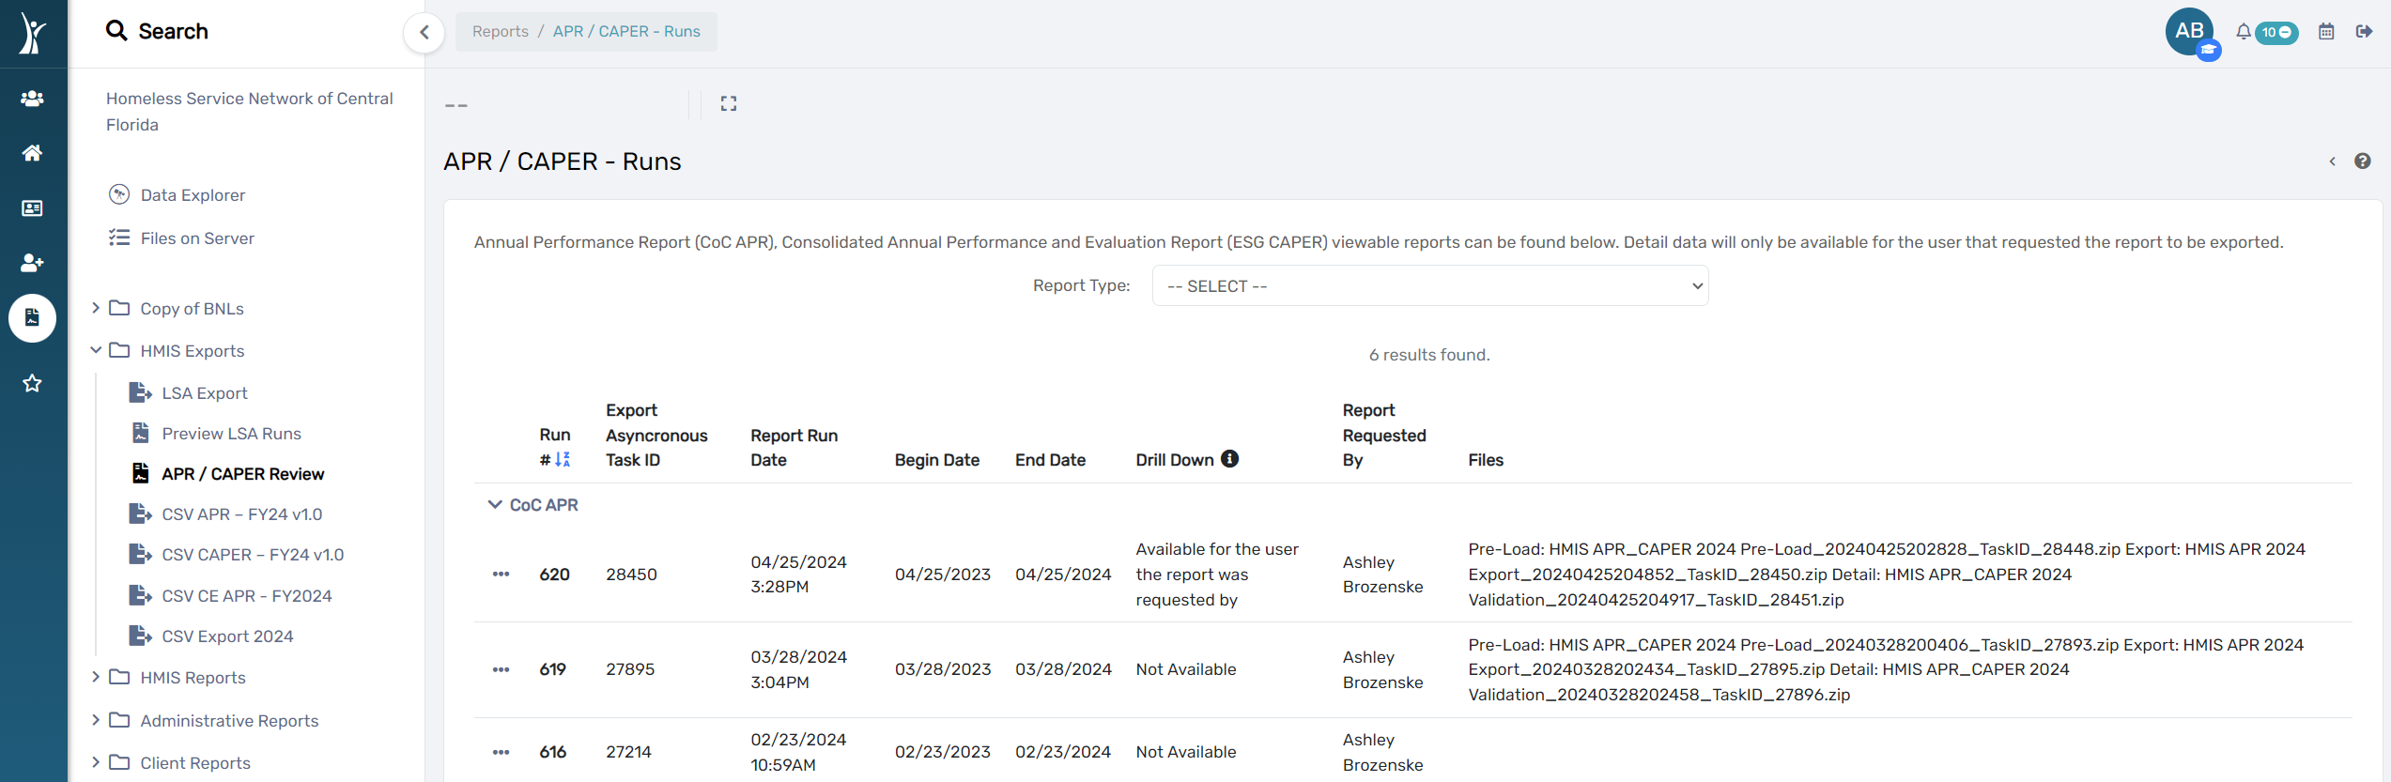
APR storage
Formatted APRs are available using the APR/CAPER review function in ClientTrack.

Slide 21


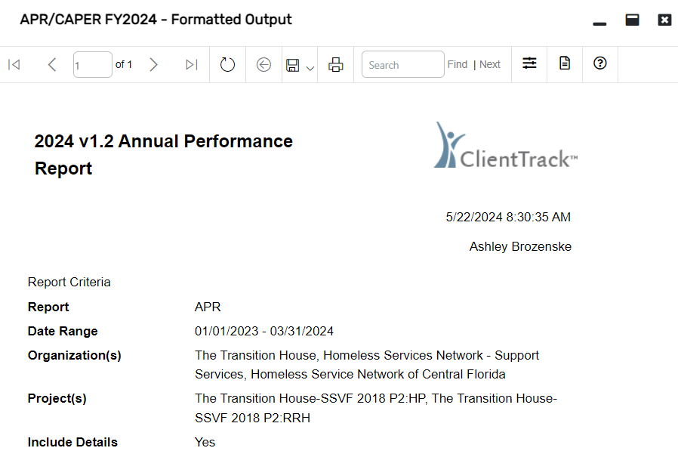








APR Menu buttons
Move to next page of report
Refresh
Go back to parent report
Save
Print
Search
Report parameters
Report log
Get help

Slide 22

Time to put your knowledge to the test!
with

Slide 23

What kinds of questions can the APR answer?

Slide 24

How many people have you served?
Q5 - Report validations table
  Count of clients
  Count of clients for DQ
  Number of Leavers
  Number of Chronically Homeless persons
  Number of Adult Head of Households

Slide 25

How many people have you served?
Q7 - Persons served
  Total number of persons served by Adults and Children
  Total number of clients served at a point in time
Q8 - Households served
  Total number of active households
  Total number of households served at a point in time

Slide 26

Who have you served?
Q9 - Contacts and Engagement
  Total number of active clients (adults or heads of household) who were contacted by street outreach workers (entered into HMIS as Current Living Situation updates) and the number of contacts made with them since their project entry.
  Total number of persons engaged (Date of Engagement entered into HMIS) during the operating year and their rate of engagement.
Q10 – Q12 - Age, Gender and Race/Ethnicity
Q13 - Physical and Mental Health Conditions
Q14 - Domestic Violence

Slide 27

Who have you served?
Q15 – Living Situation
  Living situation immediately prior to project entry
  Used to determine chronicity
Q24 - Permanent Supportive Housing specific
  Sexual Orientation of adults in PSH
  Translation assistance needed
Q25 - Veterans
Q26 - Chronically Homeless
Q27 - Youth

Slide 28

How long are your enrollments?
Q22 - Length of time
  Length of participation
  Average and median length of participation

Slide 29

How long does it take to house someone?
Q22 - Length of time
  Length of time between project start date and Housing Move in Date
    By race and ethnicity
  Length of time prior to housing (based on date homelessness started)
    By race and ethnicity

Slide 30

How have you helped the clients you've served?
Q16 - 20 - Income
  Cash and Non-Cash income changes (increase, decrease, or retention)
Q21 - Health Insurance
  Insurance changes (loss, gain, or retention)
Q23 - Exit Destinations

Slide 31

How is your Data Quality?
Q6 - Data Quality
  Personally Identifiable Information
  Universal Data Elements
  Income and Housing
  Chronic Homelessness
  Timeliness
  Inactive Records

Slide 32
Final thoughts?
Notes:
Q&A
All materials will be available on HMIS website (APR video, APR sample).
Additional support (Support sessions M&W 1-2pm, Reports training 3rd Thursday of every month 3-4:30pm, DQ report, Clients in programs report).

Slide 33

Resources
All materials will be available on HMIS website.
  Detailed APR Deep Dive slides.
  How to Run/View APRs and CAPERs in ClientTrack video.
  Sample APR
Additional support available.
  Support Sessions every Monday and Wednesday 1-2pm.
  Introduction to Reports training on the third Thursday of every month 3-4:30pm.
  Data Quality Report and Clients in Programs reports in ClientTrack are helpful for reviewing enrollment data.

Slide 34
Committee Roll-Call Vote
HMIS Committee Officers
Notes:
Presenter: Brad
Next Slide: Brad

Slide 35
Committee Roll-Call Vote
Any other motion before committee
Notes:
Presenter: Brad -Open to motions by committee members
Next Slide: Brad

Slide 36
Thank you for Attending!
Next meeting date:
Tuesday, September 10th, 2024
10:30 am to 12:00 pm
HMIS Guides, Documents, Training, Acronyms & More
hmiscfl.org
https://www.hmiscfl.org/training/datadefinitions/
Notes:
Brad Closes Meeting

Slide 37
HSN HMIS Team
Angel Jones
HMIS Operations Manager
Agustin “Tino” Paz
HMIS Senior Data Analyst
Ashley Brozenske
HMIS Data Analyst I
Brittney Behr
HMIS Project Coordinator
Racquel McGlashen
HMIS Partner Success Specialist
Tyler Claitt
HMIS System Success Specialist
Tim Reed
HMIS Partner Success Specialist

